Slide 1
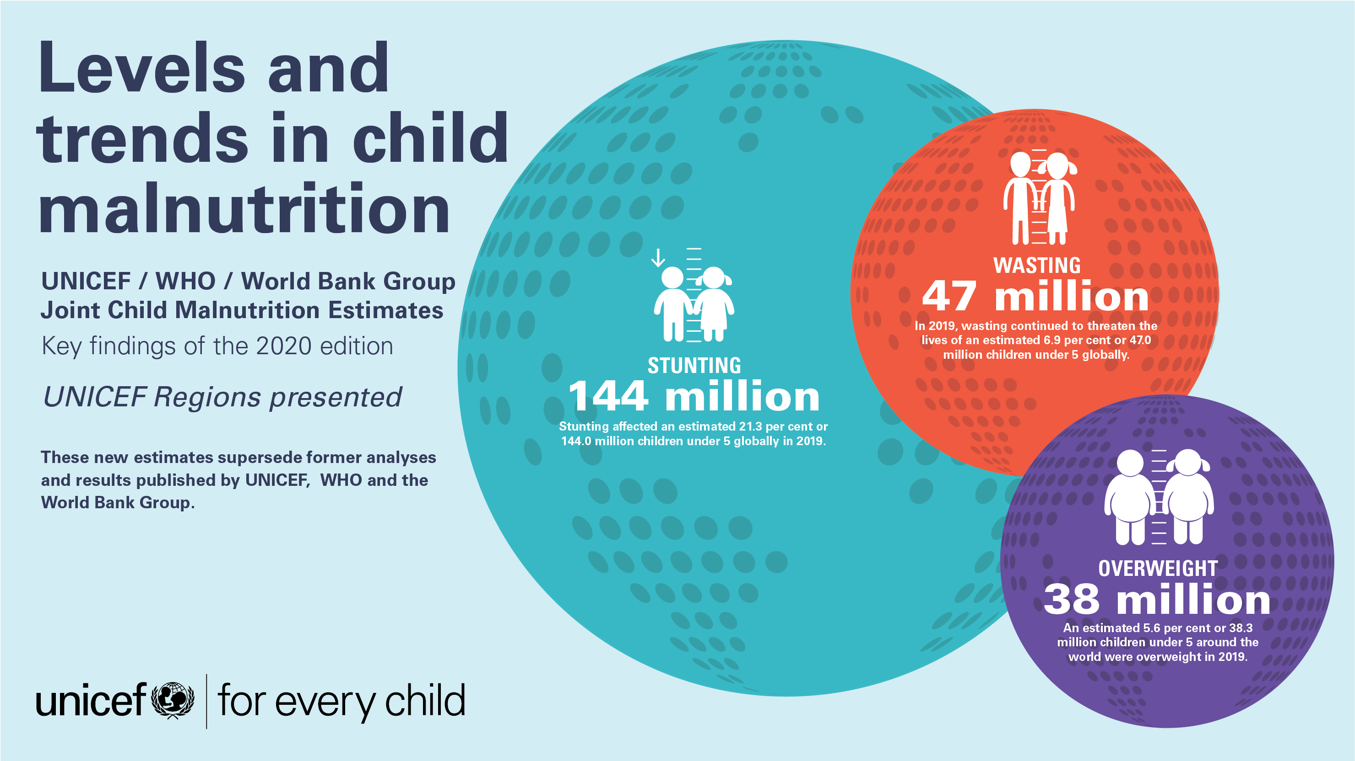

Slide 2
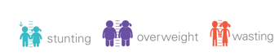
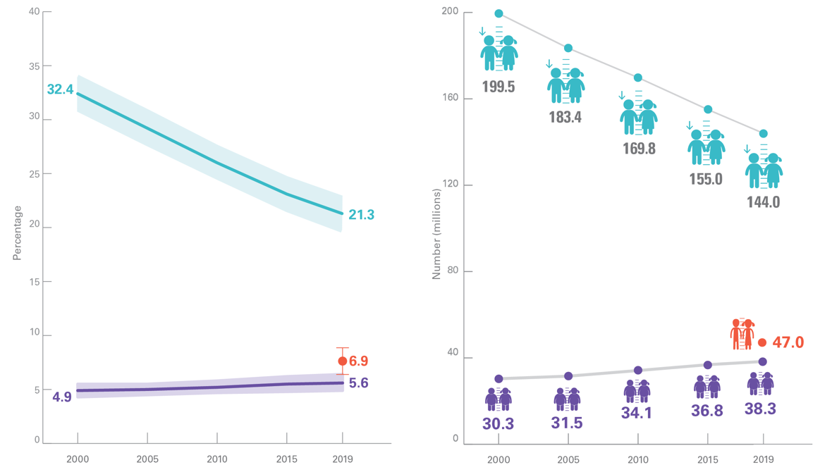
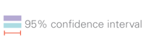
GLOBAL OVERVIEW
Prevalence and Numbers affected
Malnutrition rates remain alarming: stunting is declining too slowly while wasting still impacts the lives of far too many young children
Percentage of stunted, wasted and overweight children under 5, global, 2000–2019
Number (millions) of stunted, wasted and overweight children under 5, global, 2000–2019
Notes:
Source: UNICEF, WHO, World Bank Group joint malnutrition estimates, 2020 edition.
See Notes on the Data section for explanation of why only one time point is presented for wasting on the graphs above.

Slide 3
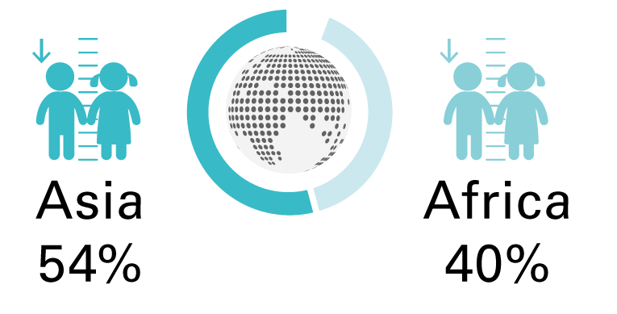
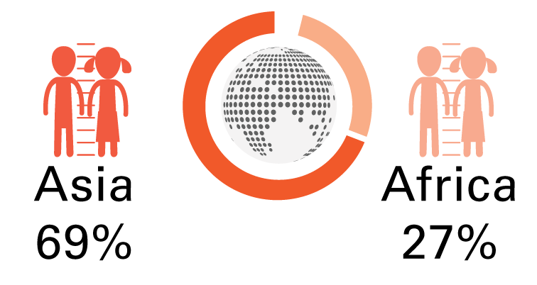
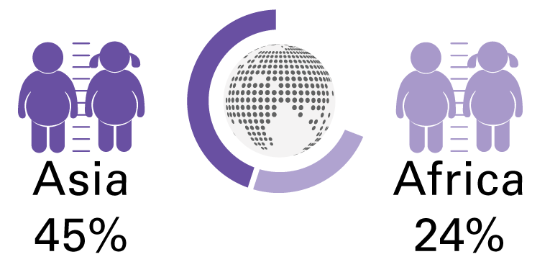
GLOBAL OVERVIEW
Africa and Asia bear the greatest share of all forms of malnutrition
In 2019, more than half of all stunted children under 5 lived in Asia and two out of five lived in Africa.
.
In 2019, more than two thirds of all wasted children under 5 lived in Asia and more than one quarter lived in Africa.
In 2019, almost half of all overweight children under 5 lived in Asia and one quarter lived in Africa.
Notes:
Source: UNICEF, WHO, World Bank Group joint malnutrition estimates, 2020 edition.

Slide 4
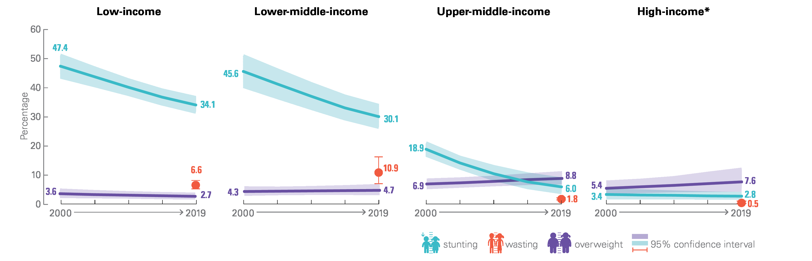
GLOBAL OVERVIEW
Prevalence trends by country-income classification
Percentage of stunted, overweight and wasted children under 5, by country income classification, 2000 – 2019
Notes:
Source: UNICEF, WHO, World Bank Group joint malnutrition estimates, 2020 edition.
Note: *High-income countries: low (<50 per cent) population coverage in all time periods for overweight and wasting, and consecutive low population coverage in 2000 for stunting; interpret with caution. Based on FY2020 World Bank country-income classification. See Notes on the Data section for explanation of why only one time point is presented for wasting on the graphs above.

Slide 5

Stunting refers to a child who is too short for his or her age. These children can suffer severe irreversible physical and cognitive damage that accompanies stunted growth. The devastating effects of stunting can last a lifetime and even affect the next generation.

Slide 6
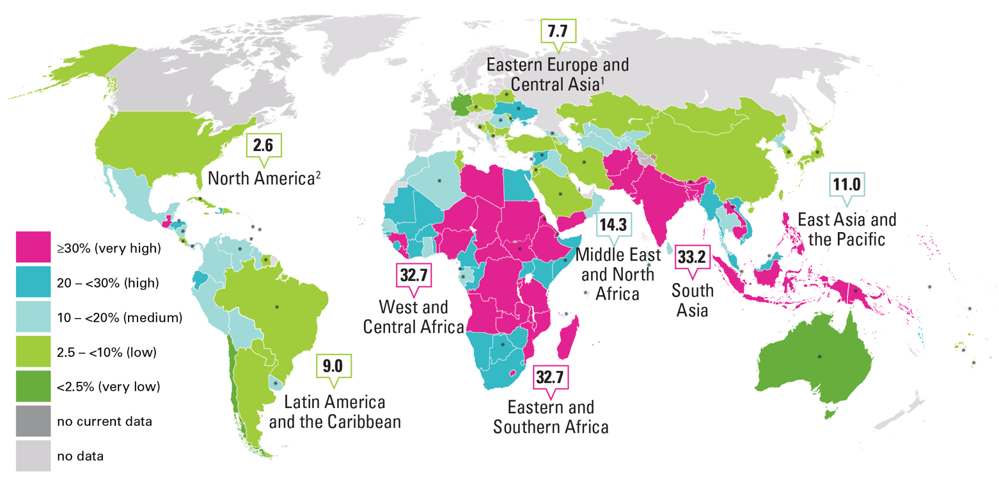
STUNTING
Prevalence by country and UNICEF region, 2019
Percentage of stunted children under 5, by country and UNICEF region, 2019
Notes:
Source: UNICEF, WHO, World Bank Group joint malnutrition estimates, 2020 edition.
Note: Country data are the most recent available estimate between 2013 and 2019; exceptions where older data (2000–2012) are shown are denoted with an asterisk(*) and where only data prior to 2000 are available the dark grey color is used denoting no recent data.
1. Eastern Europe and Central Asia does not include Russian Federation due to missing data. There is no estimate available for the Europe and Central Asia region or the Western Europe sub-region, due to insufficient population coverage. 2. North America estimate based on United States data only.
Map disclaimer: The designations employed in this publication and the presentation of the material do not imply on the part of the United Nations Children’s Fund (UNICEF) the expression of any opinion whatsoever concerning the legal status of any country or territory, or of its authorities or the delimitations of its frontiers. The dotted line represents approximately the Line of Control in Jammu and Kashmir agreed upon by India and Pakistan. The final status of Jammu and Kashmir has not yet been agreed upon by the parties. The final boundary between the Sudan and South Sudan has not yet been determined. The final status of the Abyei area has not yet been determined.

Slide 7
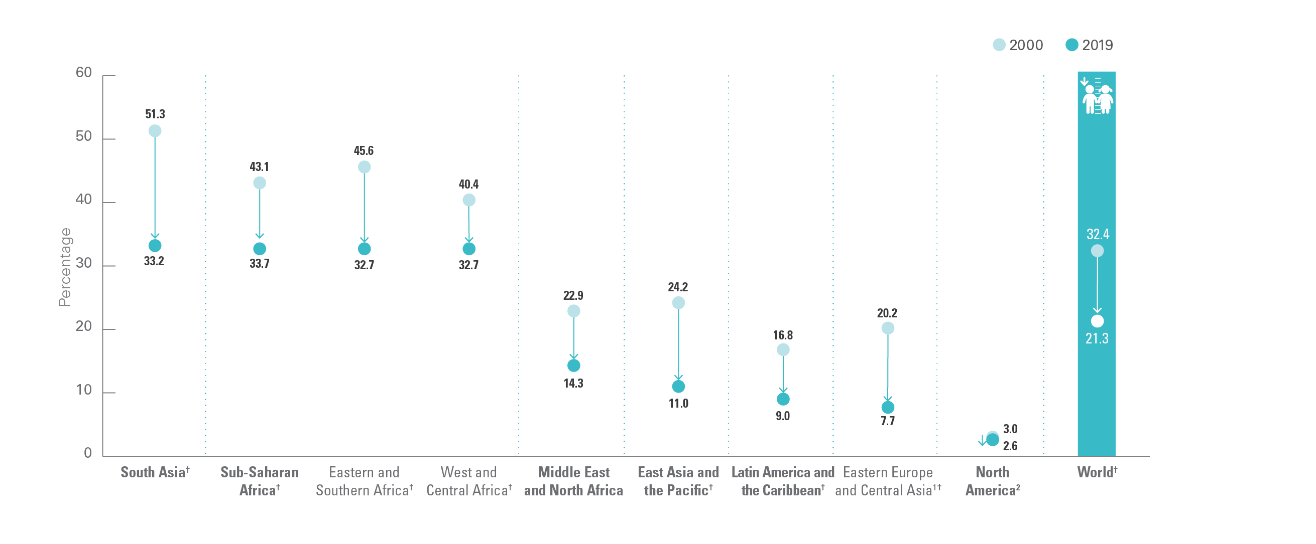
STUNTING
Prevalence trends by UNICEF region, 2000 and 2019
Trends in the percentage of stunted children under 5, by UNICEF region, 2000 and 2019
Notes:
Source: UNICEF, WHO, World Bank Group joint malnutrition estimates, 2020 edition.
Note: 1. Eastern Europe and Central Asia does not include Russian Federation due to missing data. There is no estimate available for the Europe and Central Asia region or the Western Europe sub-region, due to insufficient population coverage. 2. North America regional estimates based on United States data only. †denotes regions where the change has been statistically significant; see online materials for the 95% confidence intervals for graphed estimates at https://data.unicef.org/resources/dataset/malnutrition-data/ .

Slide 8
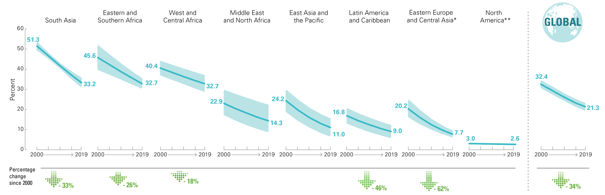
STUNTING
Prevalence trends by UNICEF region, 2000–2019
Percentage
Trends in the percentage of stunted children under 5, by UNICEF region, 2000–2019
Notes:
Source: UNICEF, WHO, World Bank Group joint malnutrition estimates, 2020 edition.
Notes: *The Eastern Europe and Central Asia sub-region estimates do not include Russian Federation due to missing data. **The North America regional average is based on United States data only, hence confidence intervals are not available. The percentage change since 2000 is only shown where the change is statistically significant.

Slide 9
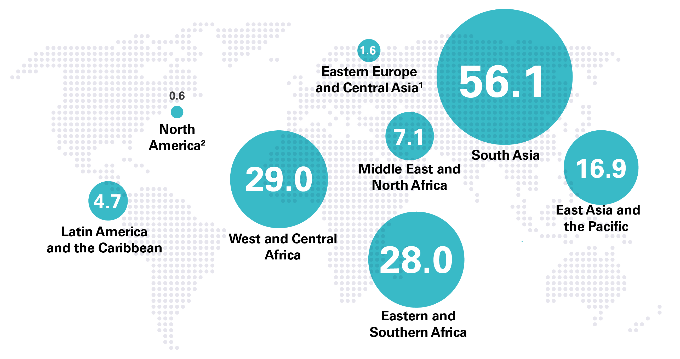
STUNTING
Numbers affected by UNICEF region, 2019
Number (millions) of stunted children under 5, by UNICEF region, 2019
Notes:
Source: UNICEF, WHO, World Bank Group joint malnutrition estimates, 2020 edition.
Note: 1. Eastern Europe and Central Asia does not include Russian Federation due to missing data. There is no estimate available for the Europe and Central Asia region or the Western Europe sub-region, due to insufficient population coverage. 2. North America estimate based on United States data. The sum of UNICEF regional estimates do not add up to global total as the global total is based on a model for United Nations regions.

Slide 10
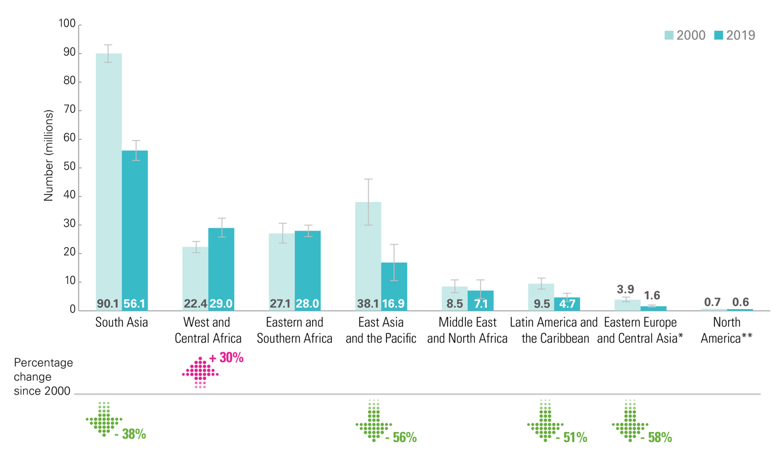
STUNTING
Trends in numbers affected by UNICEF region, 2000 & 2019
Number (millions) of children under 5 who are stunted, by UNICEF region, 2000 and 2019
Notes:
Source: UNICEF, WHO, World Bank Group joint malnutrition estimates, 2020 edition.
Notes: *The Eastern Europe and Central Asia sub-region estimates do not include Russian Federation due to missing data. **The North America regional average is based on United States data only, hence confidence intervals are not available. The percentage change since 2000 is only shown where the change is statistically significant.

Slide 11
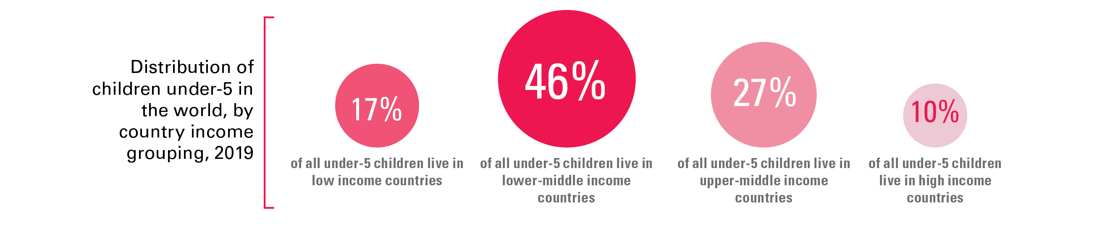
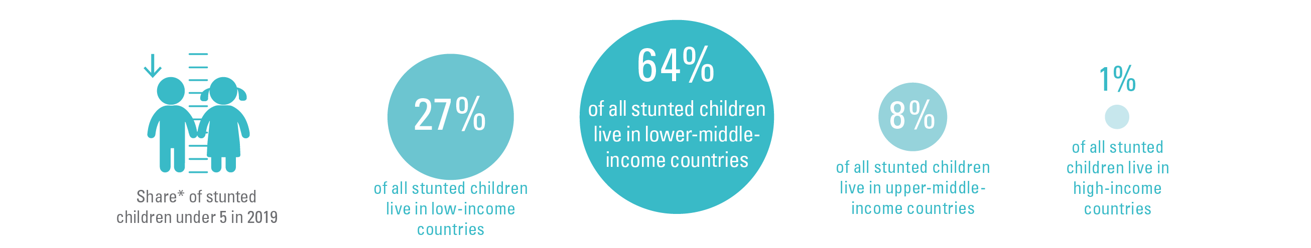
STUNTING BY COUNTRY INCOME CLASSIFICATION
Share by region
While less than half of all children under 5 live in lower-middle income countries,
two-thirds of all stunted children live there
Notes:
Source: UNICEF, WHO, World Bank Group joint malnutrition estimates, 2020 edition.
*Share is relative to the total number affected across the 4 country-income groups; this varies from the global totals reported elsewhere in this brochure because the official JME global total is based on a model of United Nations regions. The difference for stunting is as follows: Stunting official global estimate 144.0 million; sum of 4 country-income groups = 145.8 million.

Slide 12
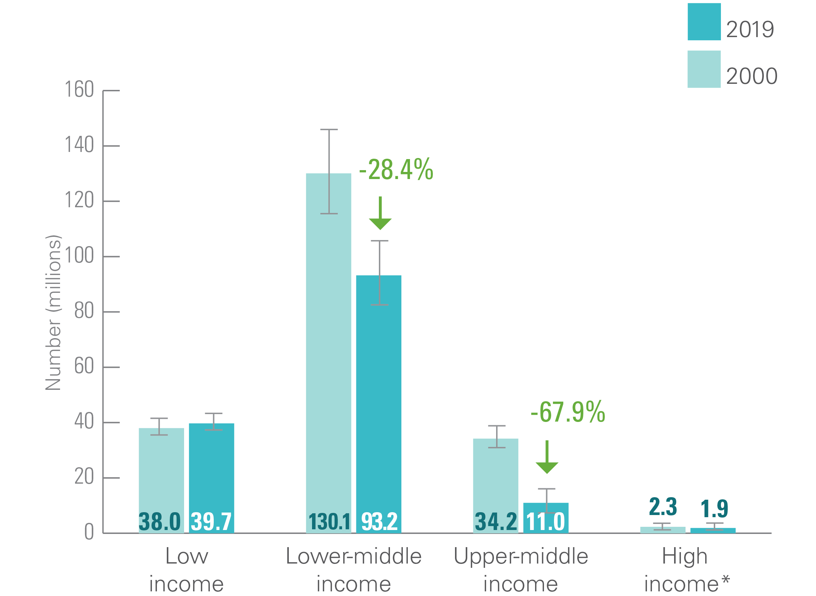
STUNTING BY COUNTRY INCOME CLASSIFICATION
Trends in numbers affected by region, 2000 and 2019
Number (millions) of children under 5 who are stunted, by World Bank Country-Income Classification, 2000 and 2019
Notes:
Source: UNICEF, WHO, World Bank Group joint malnutrition estimates, 2020 edition.
Note: *High-income countries: consecutive low (<50 per cent) population coverage in 2000; interpret with caution. Based on FY2020 World Bank country-income classification. The values in green represent the “percentage change since 2000” and are only shown where the change is statistically significant. The “percentage change since 2000” is based on calculations using unrounded estimates and therefore might not match values calculated using the rounded estimates presented on the graph.

Slide 13

Wasting refers to a child who
is too thin for his or her height.
Wasting is the result of recent
rapid weight loss or the failure
to gain weight. A child who is
moderately or severely wasted
has an increased risk of death,
but treatment is possible.

Slide 14
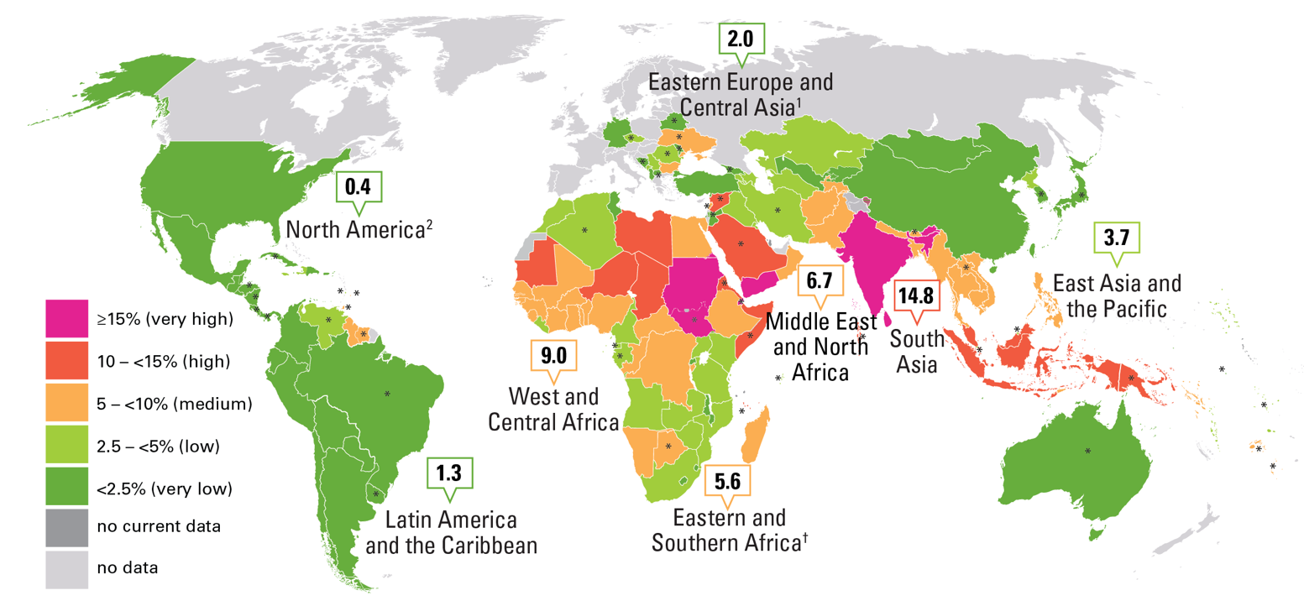
WASTING
Prevalence by country and UNICEF region, 2019
Percentage of wasted children under 5, by country and UNICEF region, 2019
Notes:
Source: UNICEF, WHO, World Bank Group joint malnutrition estimates, 2020 edition.
Note: Country data are the most recent available estimate between 2013 and 2019; exceptions where older data (2000–2012) are shown are denoted with an asterisk(*) and where only data prior to 2000 are available the dark grey color is used denoting no recent data.
1. Eastern Europe and Central Asia does not include Russian Federation due to missing data. There is no estimate available for the Europe and Central Asia region or the Western Europe sub-region, due to insufficient population coverage. 2. North America regional estimate based on United States data only.
Map disclaimer: The designations employed in this publication and the presentation of the material do not imply on the part of the United Nations Children’s Fund (UNICEF) the expression of any opinion whatsoever concerning the legal status of any country or territory, or of its authorities or the delimitations of its frontiers. The dotted line represents approximately the Line of Control in Jammu and Kashmir agreed upon by India and Pakistan. The final status of Jammu and Kashmir has not yet been agreed upon by the parties. The final boundary between the Sudan and South Sudan has not yet been determined. The final status of the Abyei area has not yet been determined.

Slide 15
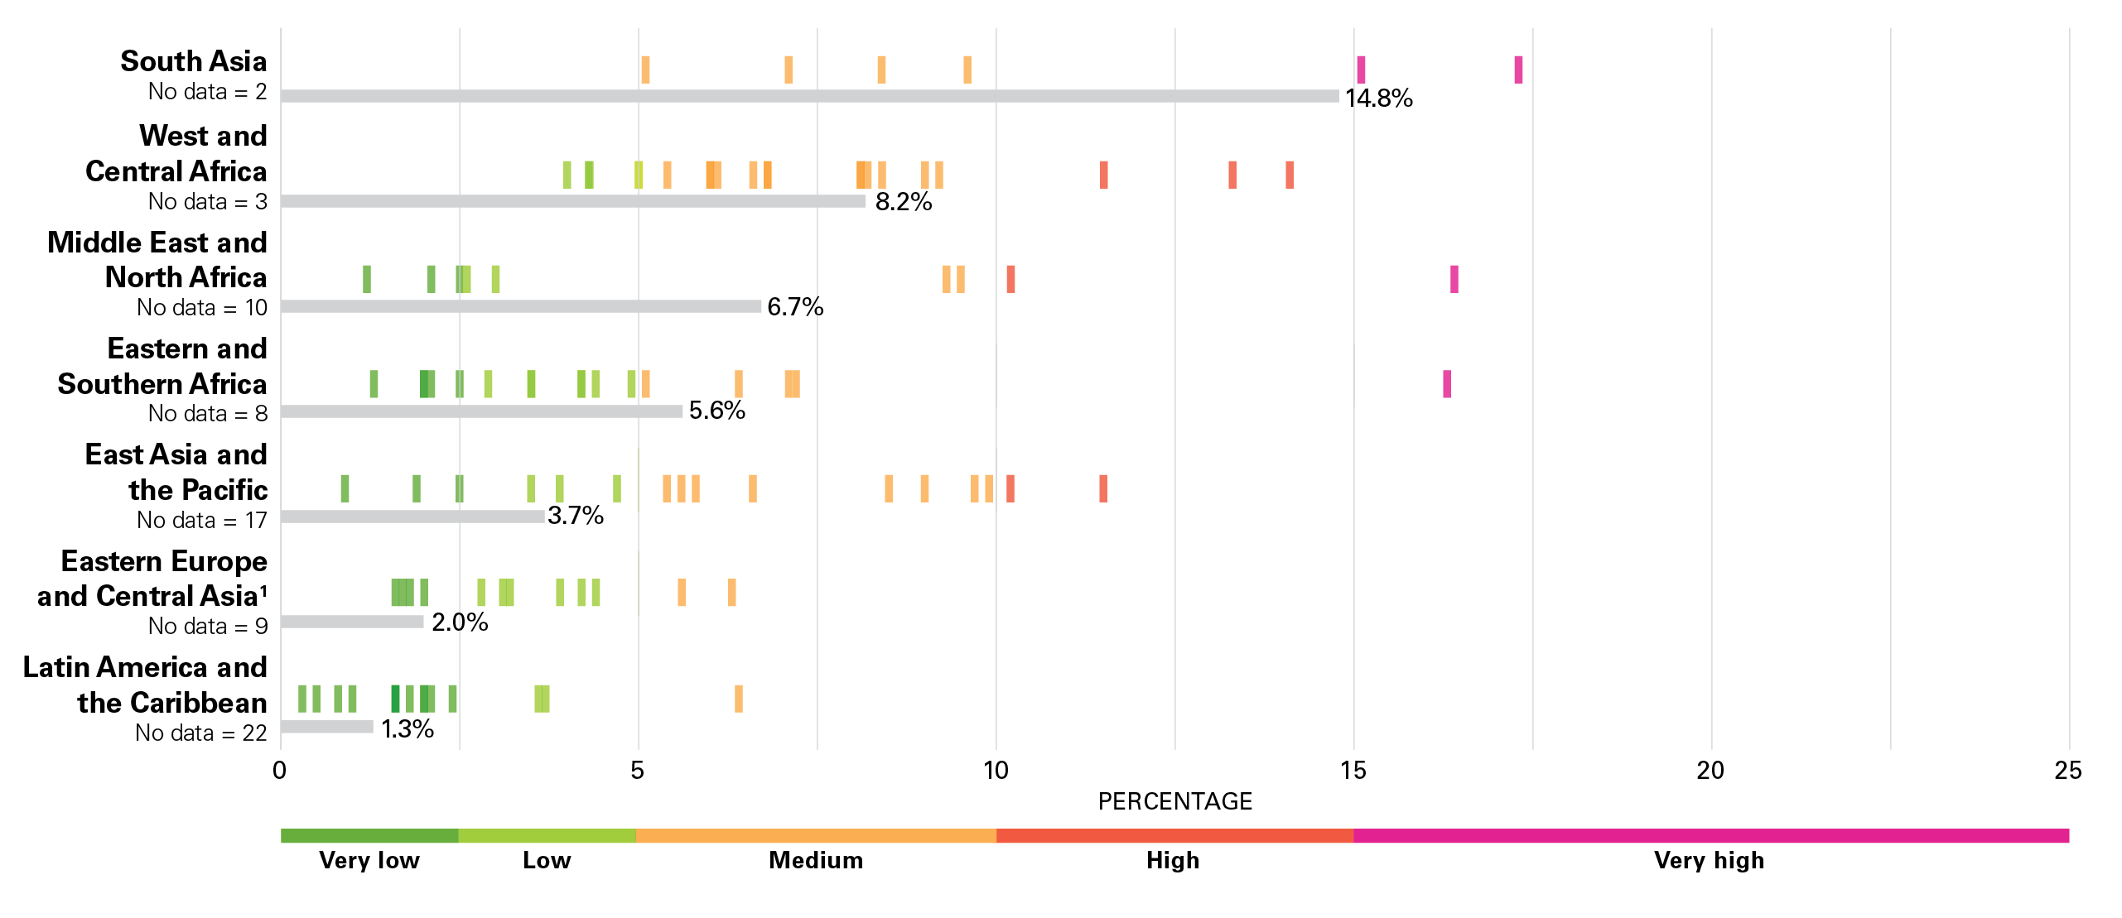
WASTING
Prevalence by country and UNICEF region, 2019
Percentage of wasted children under 5, by country (dots) and UNICEF region (bars), 2019
Notes:
Source: UNICEF, WHO, World Bank Group joint malnutrition estimates, 2020 edition.
Notes:
Each marker refers to the most recent estimate between 2013 and 2019 for each country in each region; “no data” refers to the number of countries without an estimate or for which the most recent estimate is before 2013. North America is not shown as it only includes 2 countries, of which only one has data.
Eastern Europe and Central Asia regional average does not include Russian Federation due to missing data. There is no estimate available for the Europe and Central Asia region or the Western Europe sub-region, due to insufficient population coverage.

Slide 16
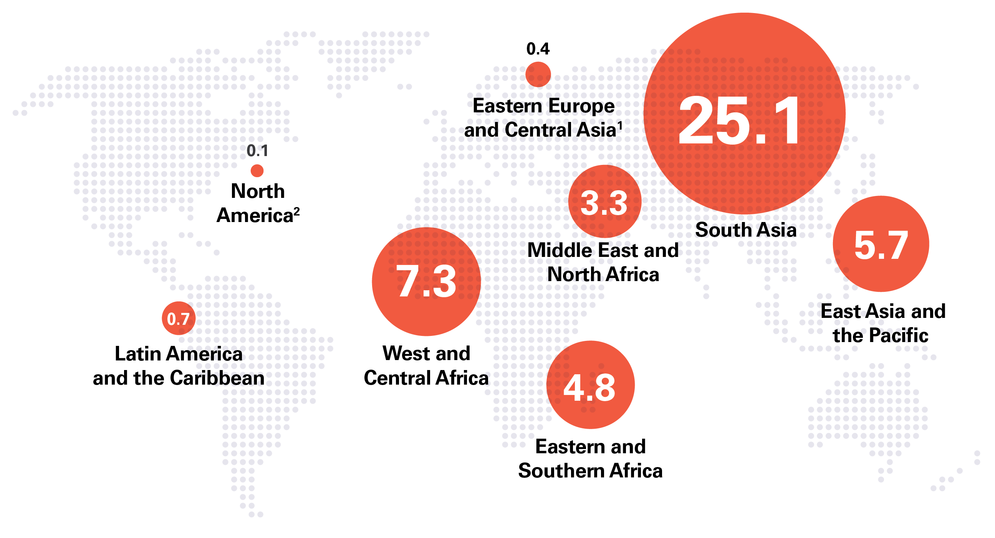
WASTING
Numbers affected by UNICEF region, 2019
Number (millions) of wasted children under 5, by UNICEF region, 2019
Notes:
Source: UNICEF, WHO, World Bank Group joint malnutrition estimates, 2020 edition.
Note: 1. Eastern Europe and Central Asia does not include Russian Federation due to missing data. There is no estimate available for the Europe and Central Asia region or the Western Europe sub-region, due to insufficient population coverage. 2. North America estimate based on United States data. The sum of UNICEF regional estimates do not add up to global total as the global total is based on a model for United Nations regions.

Slide 17
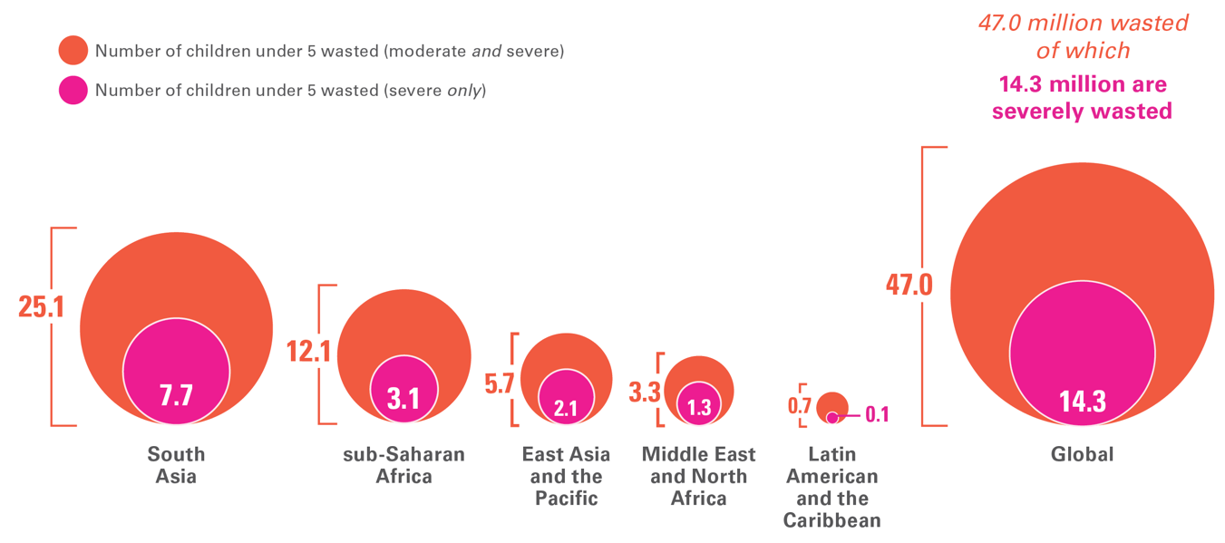
WASTING
Numbers wasted and severely wasted by UNICEF region, 2019
Number (millions) of wasted and severely wasted children under 5, by UNICEF region, 2019
Notes:
Source: UNICEF, WHO, World Bank Group joint malnutrition estimates, 2020 edition.
Note: North America as well as Europe and Central Asia are not shown due to very small numbers for severely wasted; there is no estimate available for the Europe and Central Asia region or Western Europe sub-region, due to insufficient population coverage.

Slide 18
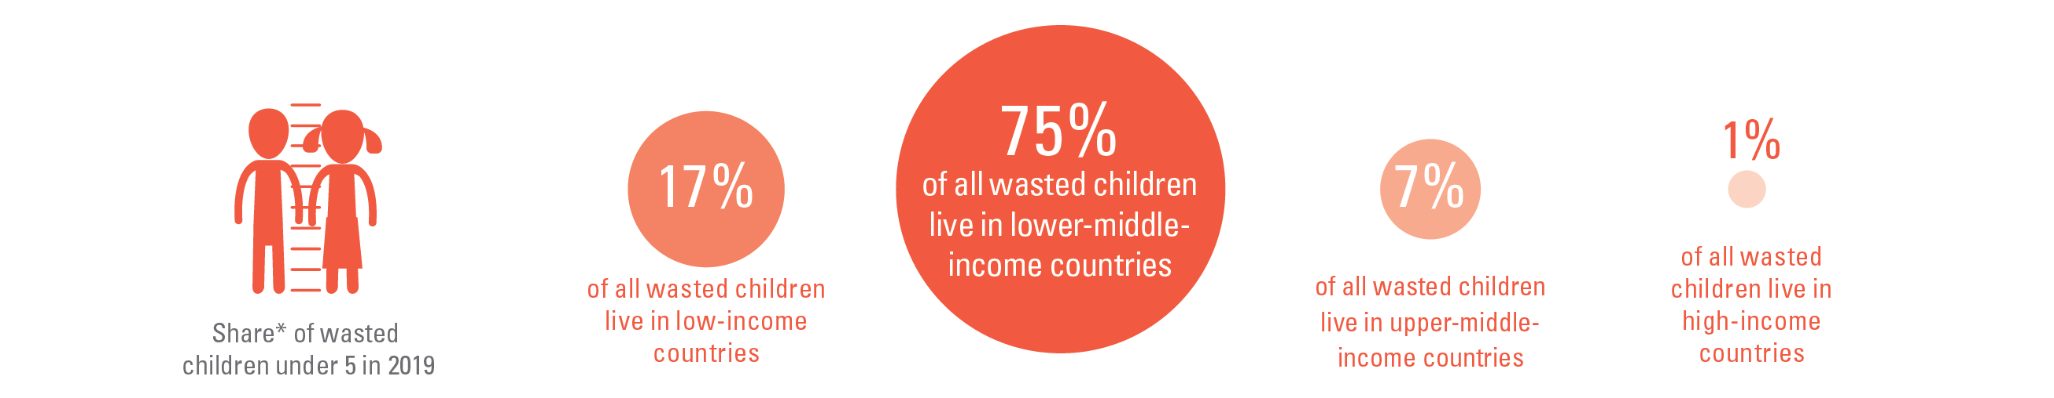
WASTING BY COUNTRY INCOME CLASSIFICATION
Share by region
While less than half of all children under 5 live in lower-middle income countries,
three-quarters of all wasted children live there
Notes:
Source: UNICEF, WHO, World Bank Group joint malnutrition estimates, 2020 edition.
*Share is relative to the total number affected across the 4 country-income groups; this varies from the global totals reported elsewhere in this brochure because the official JME global total is based on a model of United Nations regions. The difference for wasting is as follows: Wasting official global estimate 47.0 million; sum of country-income groups = 45.3 million.

Slide 19

Overweight refers to a child
who is too heavy for his or her
height. This form of malnutrition results from energy intakes from
food and beverages that exceed
children’s energy requirements.
Overweight increases the risk of diet-related non-communicable
diseases later in life.

Slide 20
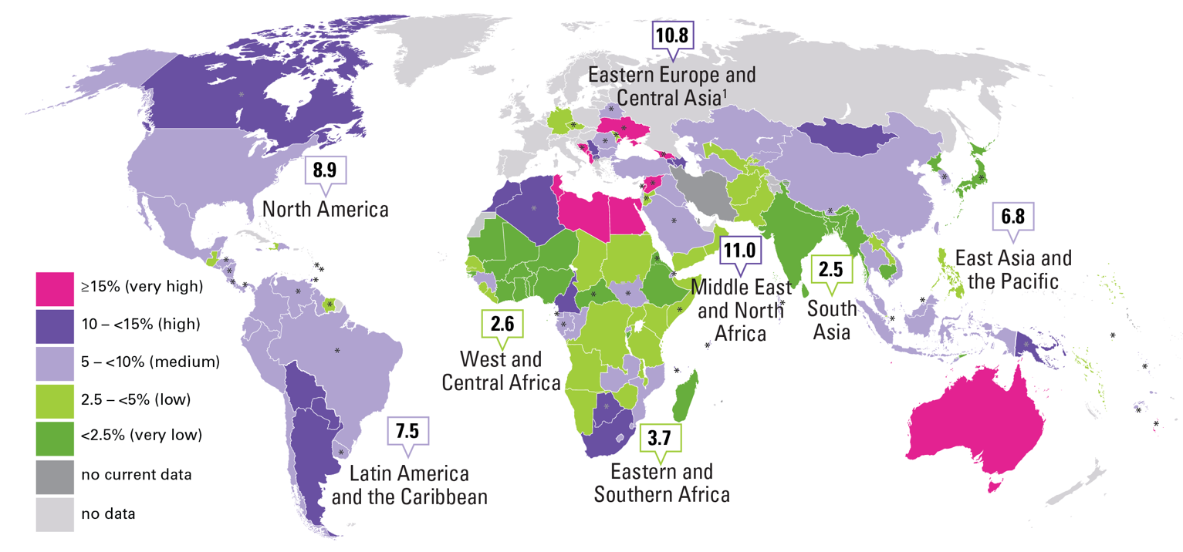
OVERWEIGHT
Prevalence by country and UNICEF region, 2019
Percentage of overweight children under 5, by country and UNICEF region, 2019
Notes:
Source: UNICEF, WHO, World Bank Group joint malnutrition estimates, 2020 edition.
Note: Country data are the most recent available estimate between 2013 and 2019; exceptions where older data (2000–2012) are shown are denoted with an asterisk(*) and where only data prior to 2000 are available the dark grey color is used denoting no recent data. 1. Eastern Europe and Central Asia does not include Russian Federation due to missing data. There is no estimate available for the Europe and Central Asia region or the Western Europe sub-region, due to insufficient population coverage.
Map disclaimer: The designations employed in this publication and the presentation of the material do not imply on the part of the United Nations Children’s Fund (UNICEF) the expression of any opinion whatsoever concerning the legal status of any country or territory, or of its authorities or the delimitations of its frontiers. The dotted line represents approximately the Line of Control in Jammu and Kashmir agreed upon by India and Pakistan. The final status of Jammu and Kashmir has not yet been agreed upon by the parties. The final boundary between the Sudan and South Sudan has not yet been determined. The final status of the Abyei area has not yet been determined.

Slide 21
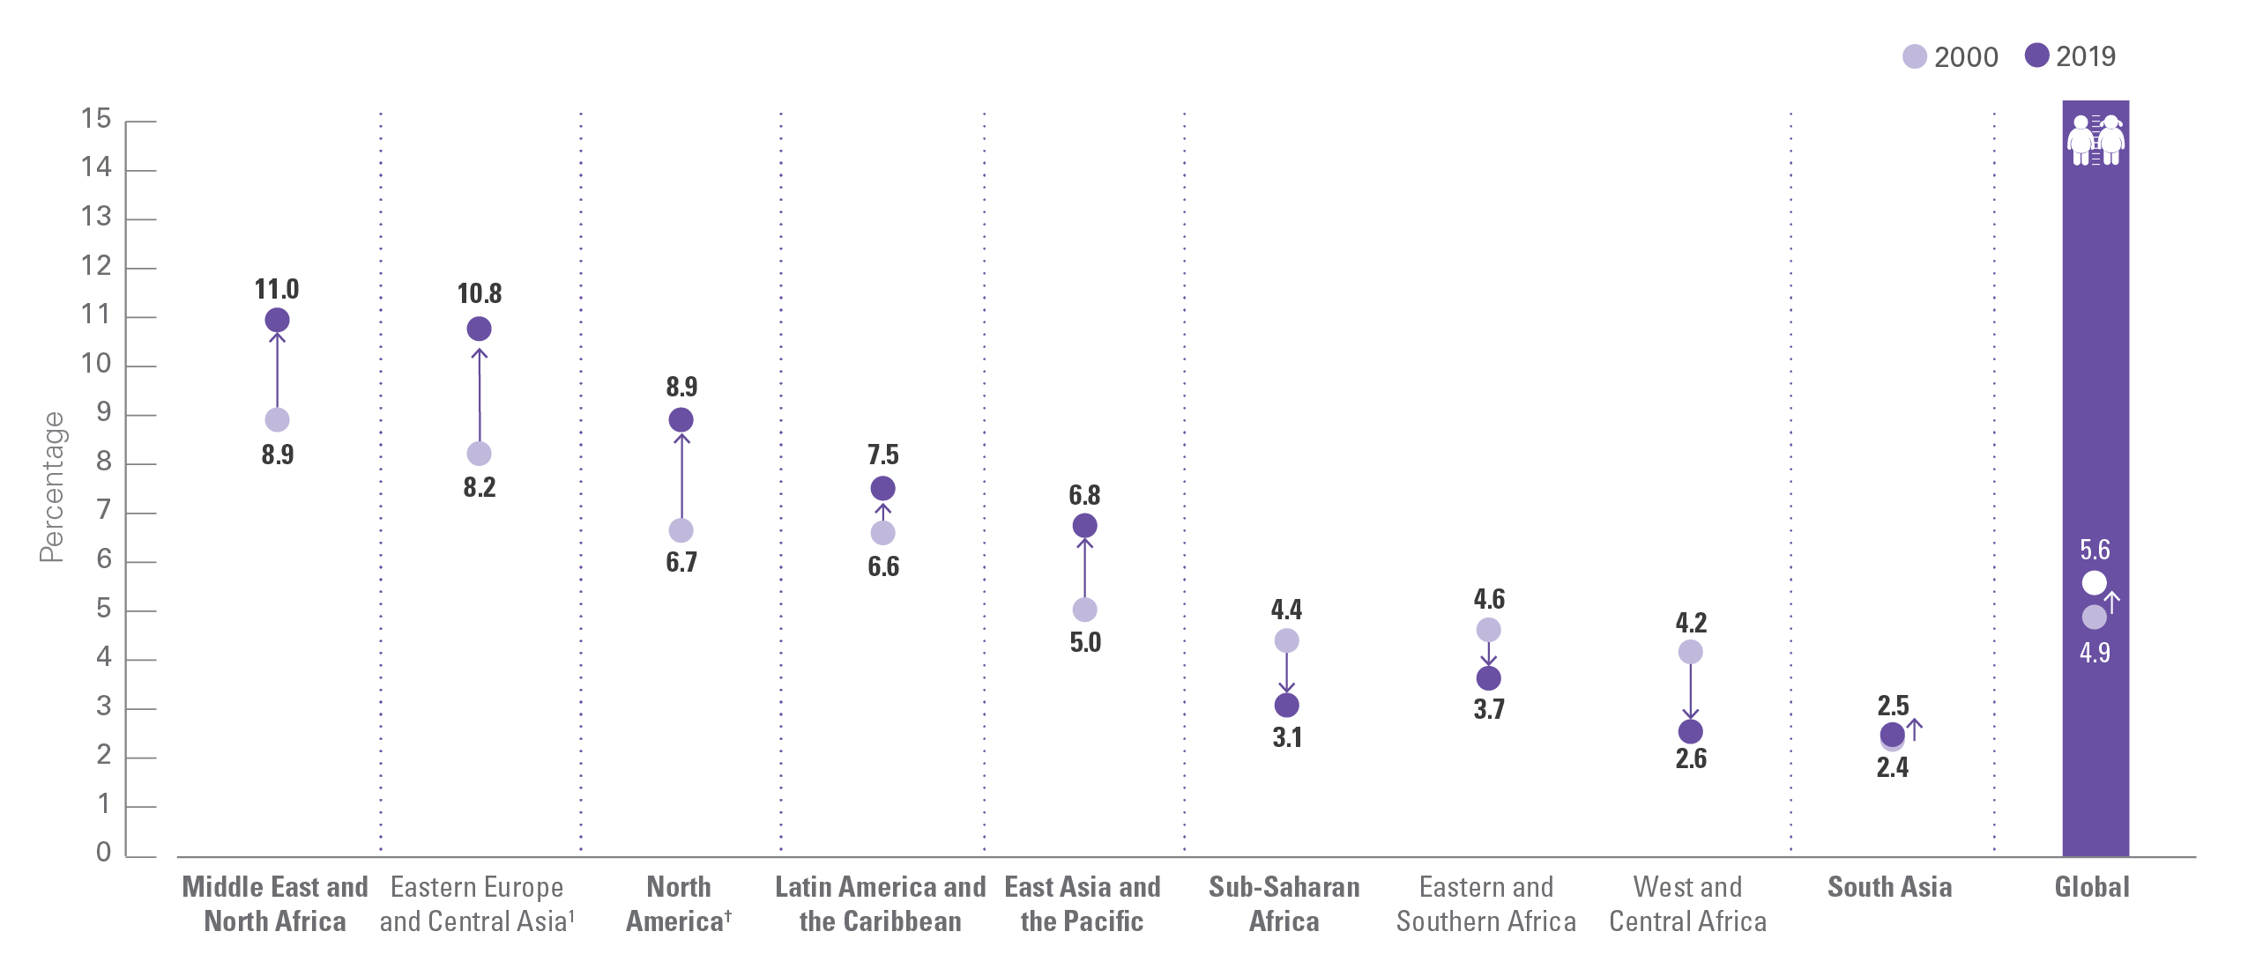
OVERWEIGHT
Trends in prevalence by UNICEF region, 2000 and 2019
Trends in the percentage of overweight children under 5, by UNICEF region, 2000 and 2019
Notes:
Source: UNICEF, WHO, World Bank Group joint malnutrition estimates, 2020 edition.
Note: 1. Eastern Europe and Central Asia does not include Russian Federation due to missing data. There is no estimate available for the Europe and Central Asia region or the Western Europe sub-region, due to insufficient population coverage. † denotes regions where the change has been statistically significant; see page 12 for the 95% confidence intervals for graphed estimates; see online materials for the 95% confidence intervals for graphed estimates at https://data.unicef.org/resources/dataset/malnutrition-data/ .

Slide 22
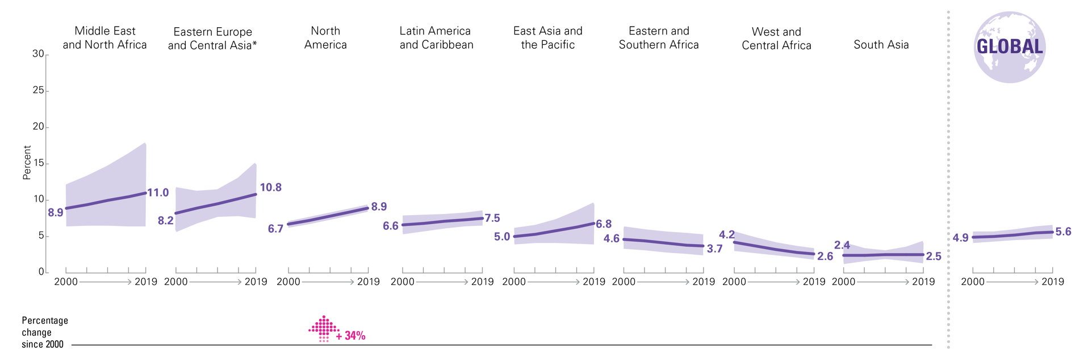
OVERWEIGHT
Trends in prevalence by UNICEF region, 2000–2019
Percentage
Trends in the percentage of overweight children under 5, by UNICEF region, 2000–2019
Notes:
Source: UNICEF, WHO, World Bank Group joint malnutrition estimates, 2020 edition.
Notes: *The Eastern Europe and Central Asia sub-region estimates do not include Russian Federation due to missing data. The percentage change since 2000 is only shown where the change is statistically significant.

Slide 23
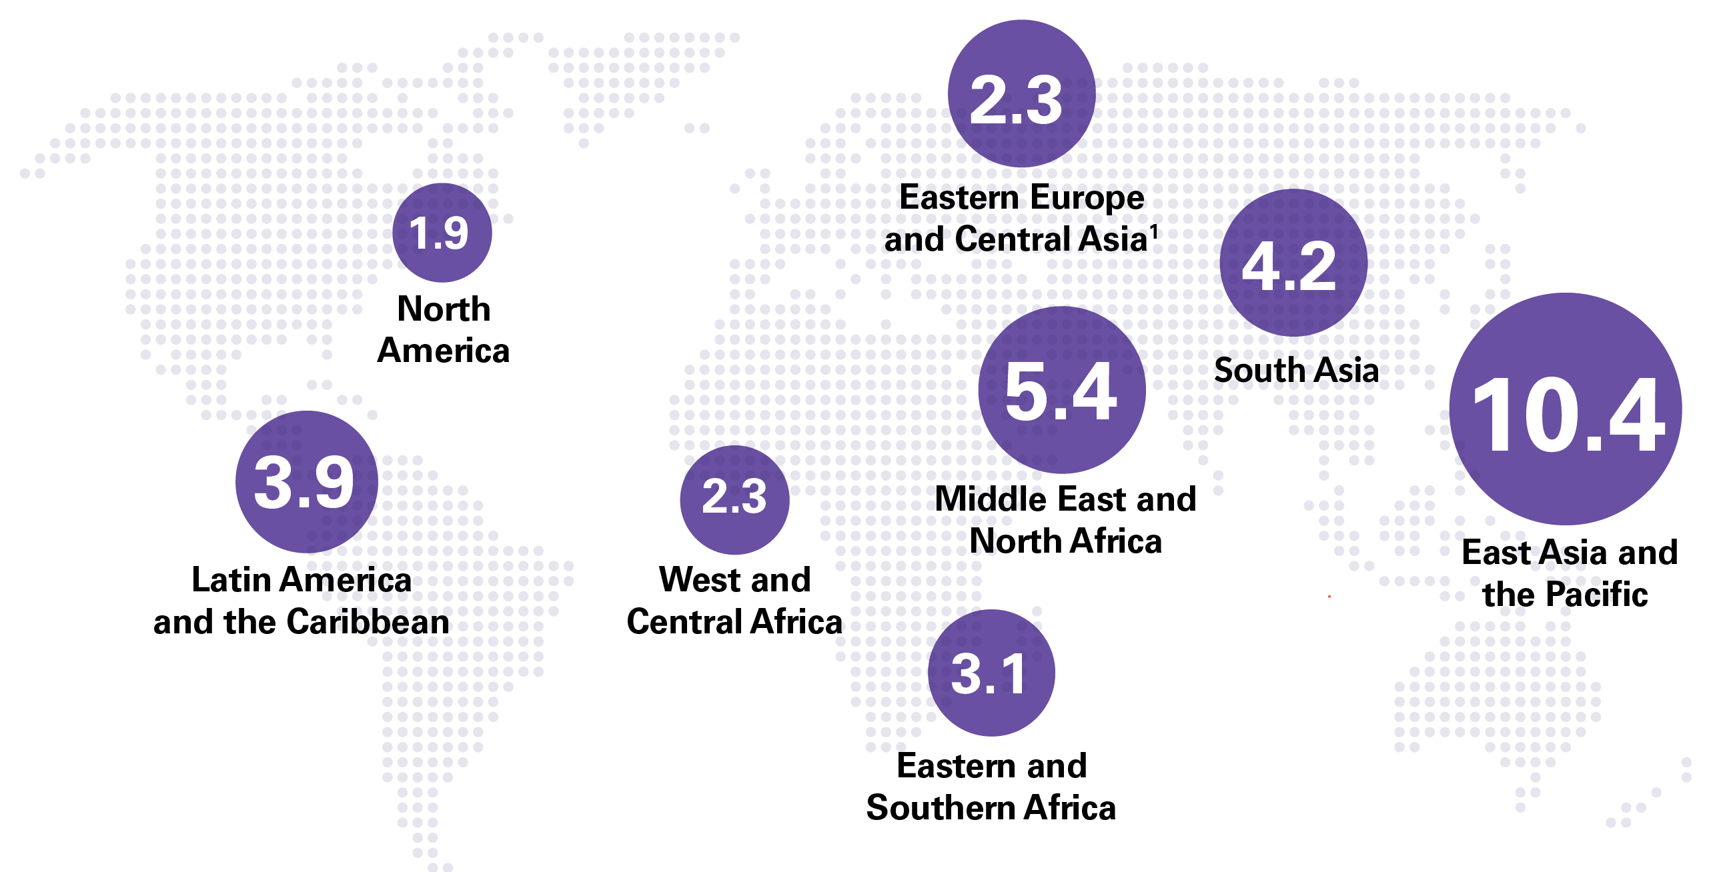
OVERWEIGHT
Numbers affected by UNICEF region, 2019
Number (millions) of overweight children under 5, by UNICEF region, 2019
Notes:
Source: UNICEF, WHO, World Bank Group joint malnutrition estimates, 2020 edition. Note: 1. Eastern Europe and Central Asia does not include Russian Federation due to missing data. There is no estimate available for the Europe and Central Asia region or the Western Europe sub-region, due to insufficient population coverage. The sum of UNICEF regional estimates do not add up to global total as the global total is based on a model for United Nations regions.

Slide 24
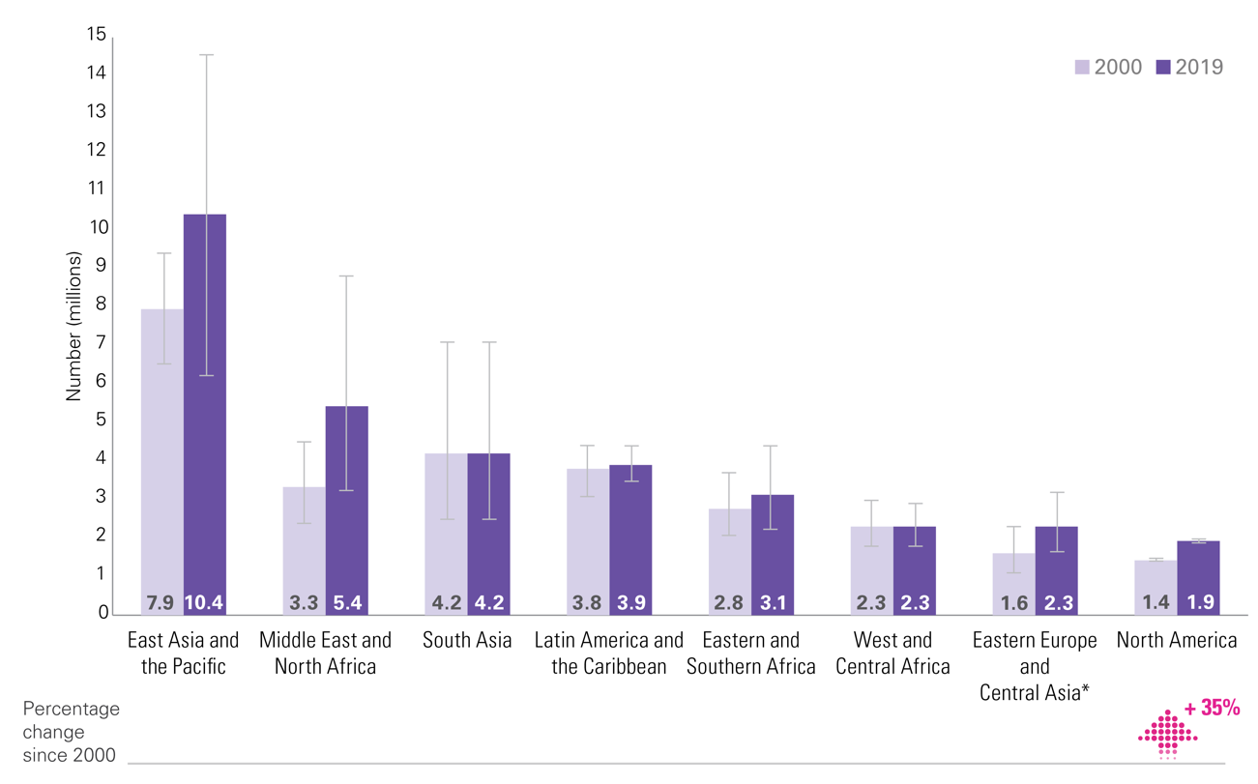
OVERWEIGHT
Trends in numbers affected by UNICEF region, 2000 & 2019
Number (millions) of children under 5 who are overweight, by UNICEF region, 2000 and 2019
Notes:
Source: Source: UNICEF, WHO, World Bank Group Joint Child Malnutrition Estimates, 2019 edition.​ Note: * Eastern Europe and Central Asia sub-region does not include Russian Federation due to missing data. The percentage change since 2000 is only shown where the change is statistically significant

Slide 25
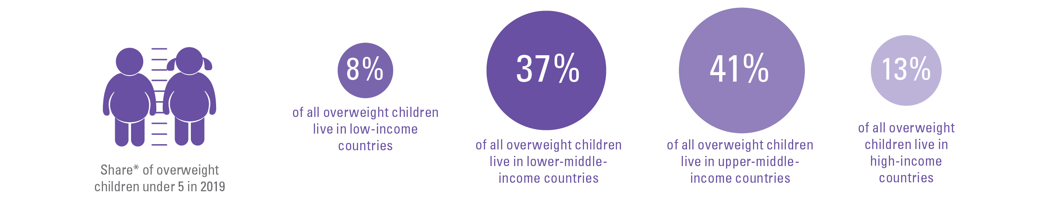
OVERWEIGHT BY COUNTRY INCOME CLASSIFICATION
Share by region
While only one in four children under 5 live in upper-middle income countries,
two out of five of all overweight children live there
Notes:
Source: UNICEF, WHO, World Bank Group joint malnutrition estimates, 2020 edition.
*Share is relative to the total number affected across the 4 country-income groups; this varies from the global totals reported elsewhere in this brochure because the official JME global total is based on a model of United Nations regions. The difference for overweight is as follows: Overweight official global estimate 38.3 million; sum of 4 country-income groups = 39.1 million).

Slide 26
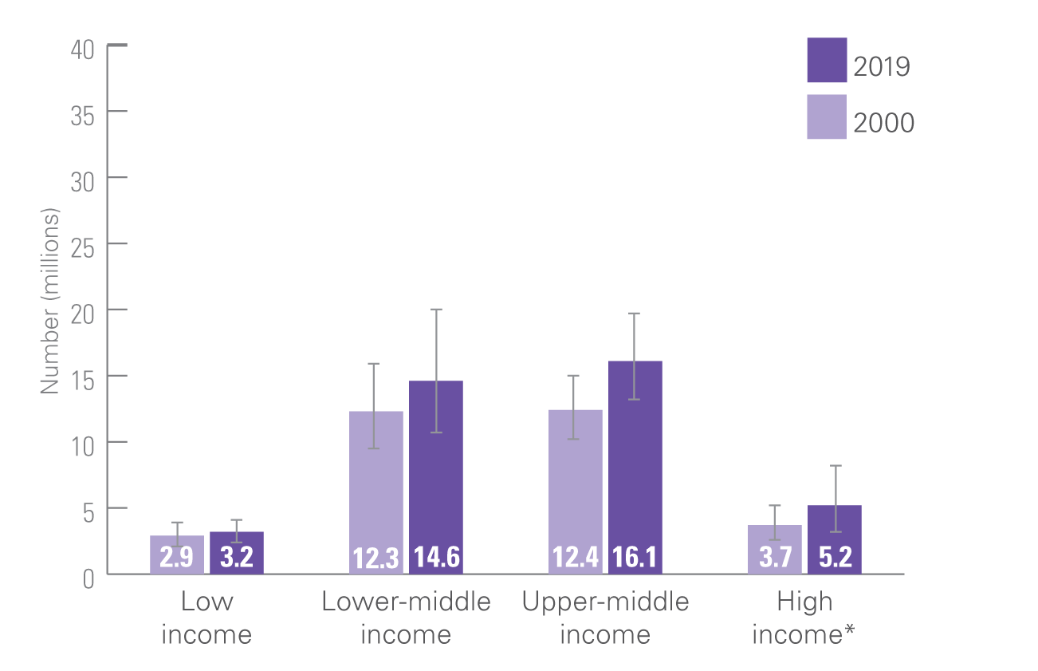
OVERWEIGHT BY COUNTRY INCOME CLASSIFICATION
Trends in numbers affected by region, 2000 and 2019
Number (millions) of children under 5 who are overweight, by World Bank Country-Income Classification, 2000 and 2019
Notes:
Source: UNICEF, WHO, World Bank Group joint malnutrition estimates, 2020 edition. Note: *High-income countries: consecutive low (<50 per cent) population coverage in 2000 and 2019 for overweight and in 2000 for stunting; interpret with caution. Based on FY2020 World Bank income classification. There are no values for “percentage change since 2000” on this graphic (like there are on the stunting graphic) as none of the changes since 2000 for overweight are statistically significant.

Slide 27
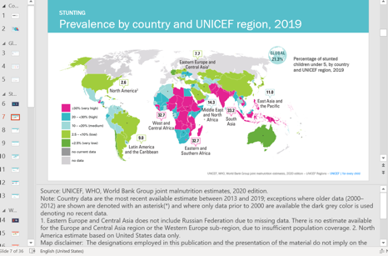
Notes and Disclaimers
The slides are based on outputs of the UNICEF, WHO, World Bank Group Joint Malnutrition Estimates, 2020 Edition.
Many slides contain notes and disclaimers in the notes section of the slide.
These notes need to be retained even when individual slides are used in other PowerPoints or added to documents.
Please ensure the notes and disclaimers are retained in all uses of these materials.
Example of note section in slides which contains key information including notes and disclaimers. These notes need to be retained even when used in another presentation or document.

Slide 28
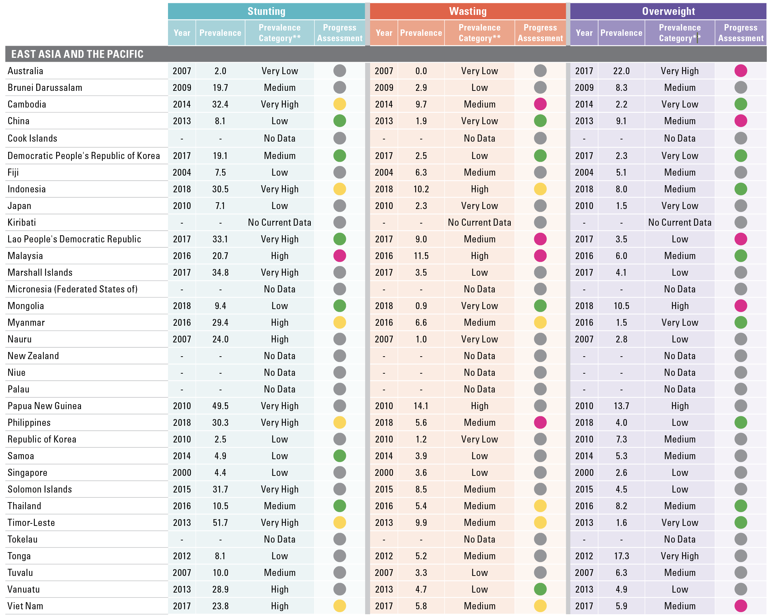
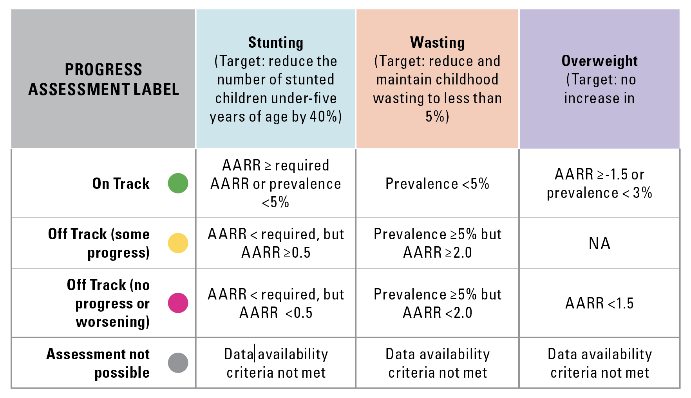
Country Prevalence Table*
East Asia and the Pacific
Notes on Progress Assessment: The progress assessment is done against the Sustainable Development Goal Target 2.2 for 2025 using an adapted version of rules from the WHO-UNICEF Technical Expert Advisory Group on Nutrition Monitoring¹ and all available country data between 2008 and 2019 in the 2020 JME country dataset. The annual average rate of reduction (AARR) is calculated for each indicator requiring at least 2 data points, one of which must be more recent than 2012. Alternatively, countries are recorded as being on track if their most recent data point after 2012 is below the on track threshold (e.g. 5% for stunting) even if they have <2 data points in total. Countries not meeting these data availability criteria are reported as “Assessment not possible”.
Notes:
*The most recent estimate between 2000 and 2019 in the JME country dataset is reported in this table, see page 43 for link to full country time series. **See page 40 for prevalence thresholds; No current data means the most recent estimate is from before 2000.
¹ Methodology for monitoring progress towards the global nutrition targets for 2025 – technical report. World Health Organization and the United Nations Children’s Fund (UNICEF) Technical Expert Advisory Group on Nutrition Monitoring (TEAM), 2017. Licence: CC BY-NC-SA 3.0 IGO.

Slide 29
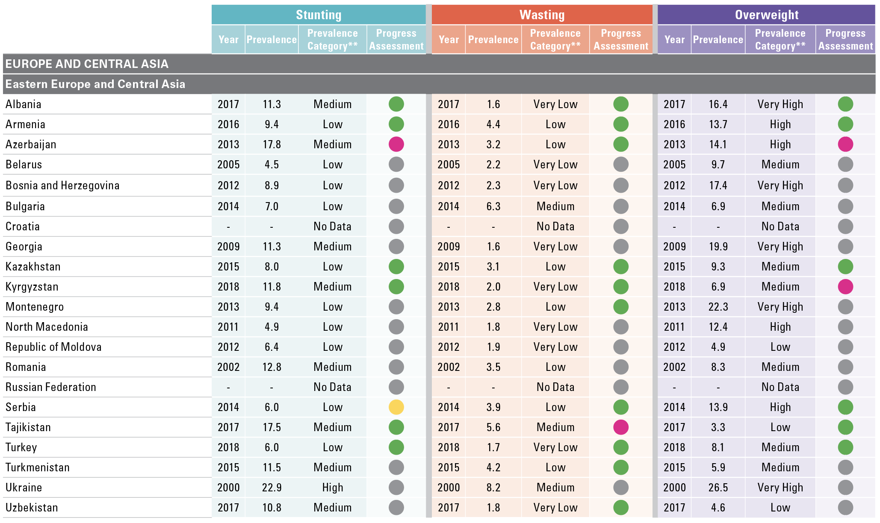
Country Prevalence Table*
Eastern Europe and Central Asia
Notes on Progress Assessment: The progress assessment is done against the Sustainable Development Goal Target 2.2 for 2025 using an adapted version of rules from the WHO-UNICEF Technical Expert Advisory Group on Nutrition Monitoring¹ and all available country data between 2008 and 2019 in the 2020 JME country dataset. The annual average rate of reduction (AARR) is calculated for each indicator requiring at least 2 data points, one of which must be more recent than 2012. Alternatively, countries are recorded as being on track if their most recent data point after 2012 is below the on track threshold (e.g. 5% for stunting) even if they have <2 data points in total. Countries not meeting these data availability criteria are reported as “Assessment not possible”.
Notes:
*The most recent estimate between 2000 and 2019 in the JME country dataset is reported in this table, see page 43 for link to full country time series. **See page 40 for prevalence thresholds; No current data means the most recent estimate is from before 2000.
¹ Methodology for monitoring progress towards the global nutrition targets for 2025 – technical report. World Health Organization and the United Nations Children’s Fund (UNICEF) Technical Expert Advisory Group on Nutrition Monitoring (TEAM), 2017. Licence: CC BY-NC-SA 3.0 IGO.

Slide 30
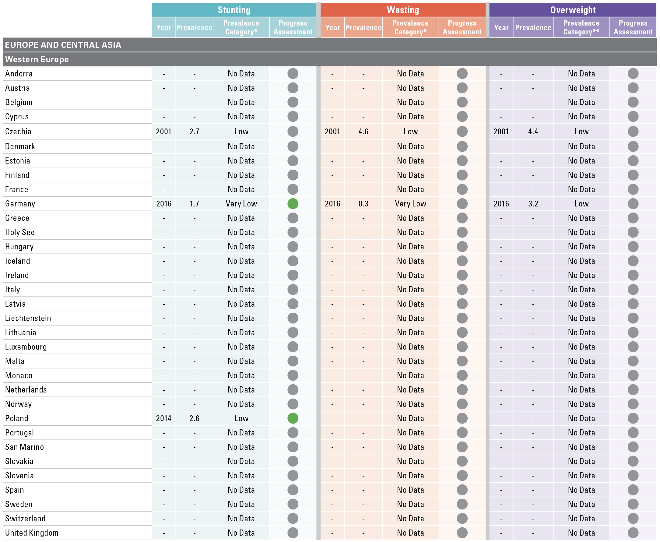
Country Prevalence Table*
Western Europe
Notes on Progress Assessment: The progress assessment is done against the Sustainable Development Goal Target 2.2 for 2025 using an adapted version of rules from the WHO-UNICEF Technical Expert Advisory Group on Nutrition Monitoring¹ and all available country data between 2008 and 2019 in the 2020 JME country dataset. The annual average rate of reduction (AARR) is calculated for each indicator requiring at least 2 data points, one of which must be more recent than 2012. Alternatively, countries are recorded as being on track if their most recent data point after 2012 is below the on track threshold (e.g. 5% for stunting) even if they have <2 data points in total. Countries not meeting these data availability criteria are reported as “Assessment not possible”.
Notes:
*The most recent estimate between 2000 and 2019 in the JME country dataset is reported in this table, see page 43 for link to full country time series. **See page 40 for prevalence thresholds; No current data means the most recent estimate is from before 2000.
¹ Methodology for monitoring progress towards the global nutrition targets for 2025 – technical report. World Health Organization and the United Nations Children’s Fund (UNICEF) Technical Expert Advisory Group on Nutrition Monitoring (TEAM), 2017. Licence: CC BY-NC-SA 3.0 IGO.

Slide 31
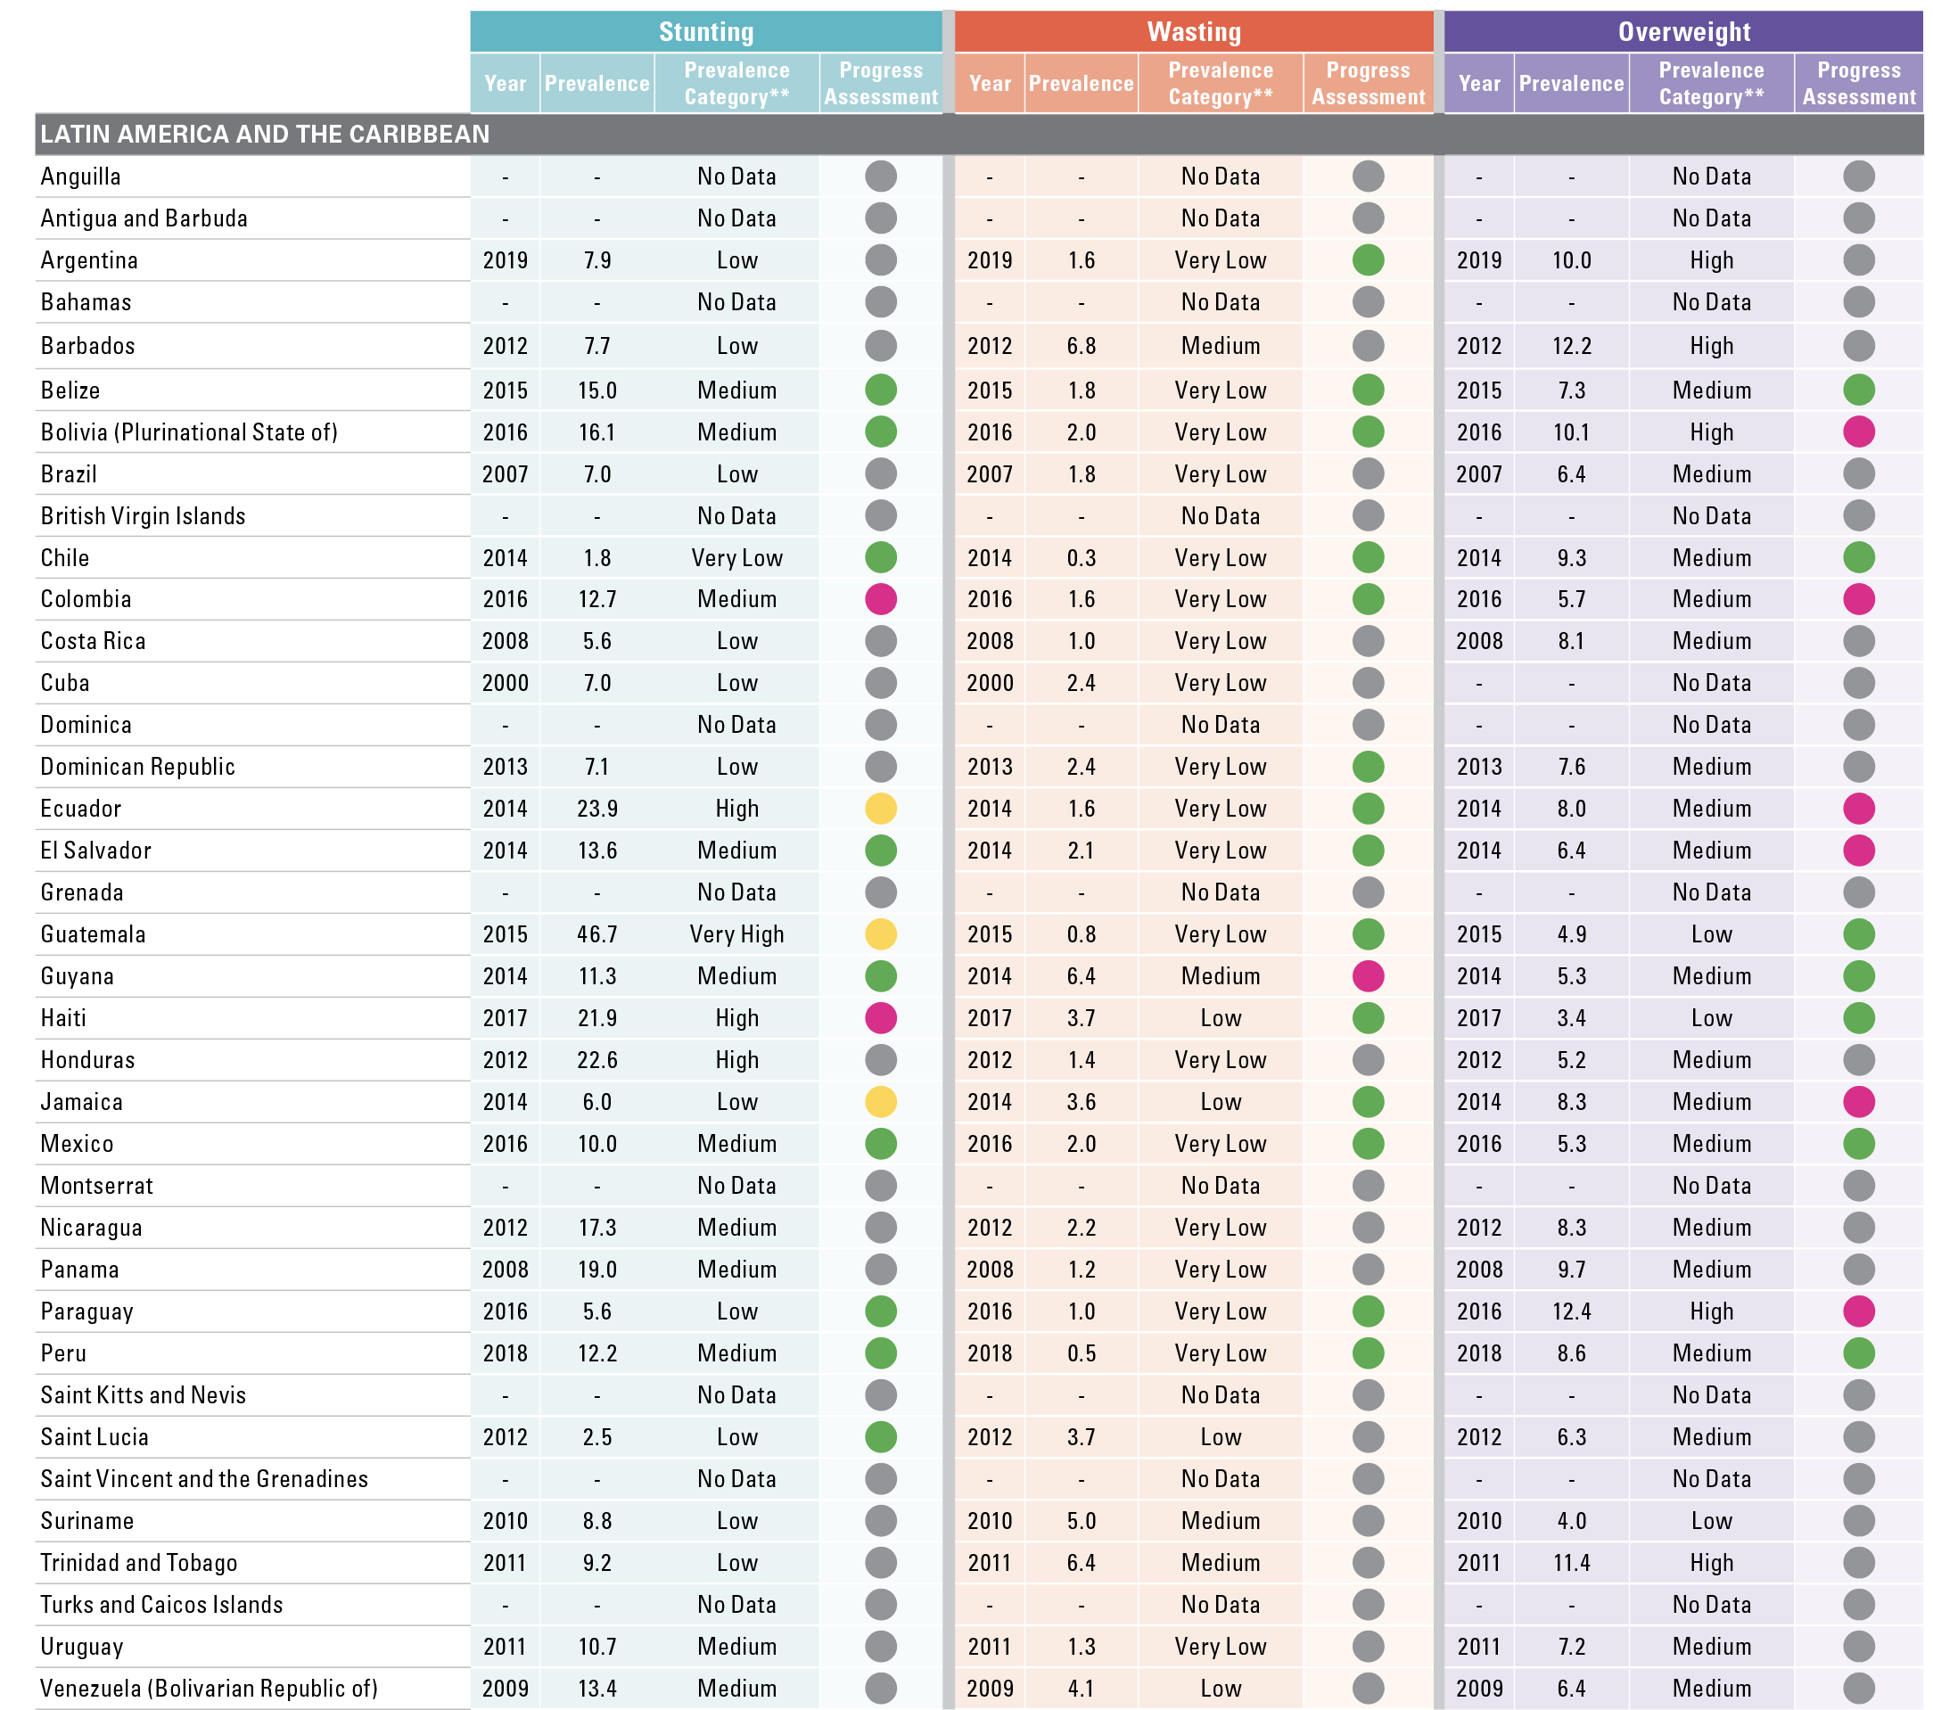
Country Prevalence Table*
Latin America and the Caribbean
Notes on Progress Assessment: The progress assessment is done against the Sustainable Development Goal Target 2.2 for 2025 using an adapted version of rules from the WHO-UNICEF Technical Expert Advisory Group on Nutrition Monitoring¹ and all available country data between 2008 and 2019 in the 2020 JME country dataset. The annual average rate of reduction (AARR) is calculated for each indicator requiring at least 2 data points, one of which must be more recent than 2012. Alternatively, countries are recorded as being on track if their most recent data point after 2012 is below the on track threshold (e.g. 5% for stunting) even if they have <2 data points in total. Countries not meeting these data availability criteria are reported as “Assessment not possible”.
Notes:
*The most recent estimate between 2000 and 2019 in the JME country dataset is reported in this table, see page 43 for link to full country time series. **See page 40 for prevalence thresholds; No current data means the most recent estimate is from before 2000.
¹ Methodology for monitoring progress towards the global nutrition targets for 2025 – technical report. World Health Organization and the United Nations Children’s Fund (UNICEF) Technical Expert Advisory Group on Nutrition Monitoring (TEAM), 2017. Licence: CC BY-NC-SA 3.0 IGO.

Slide 32
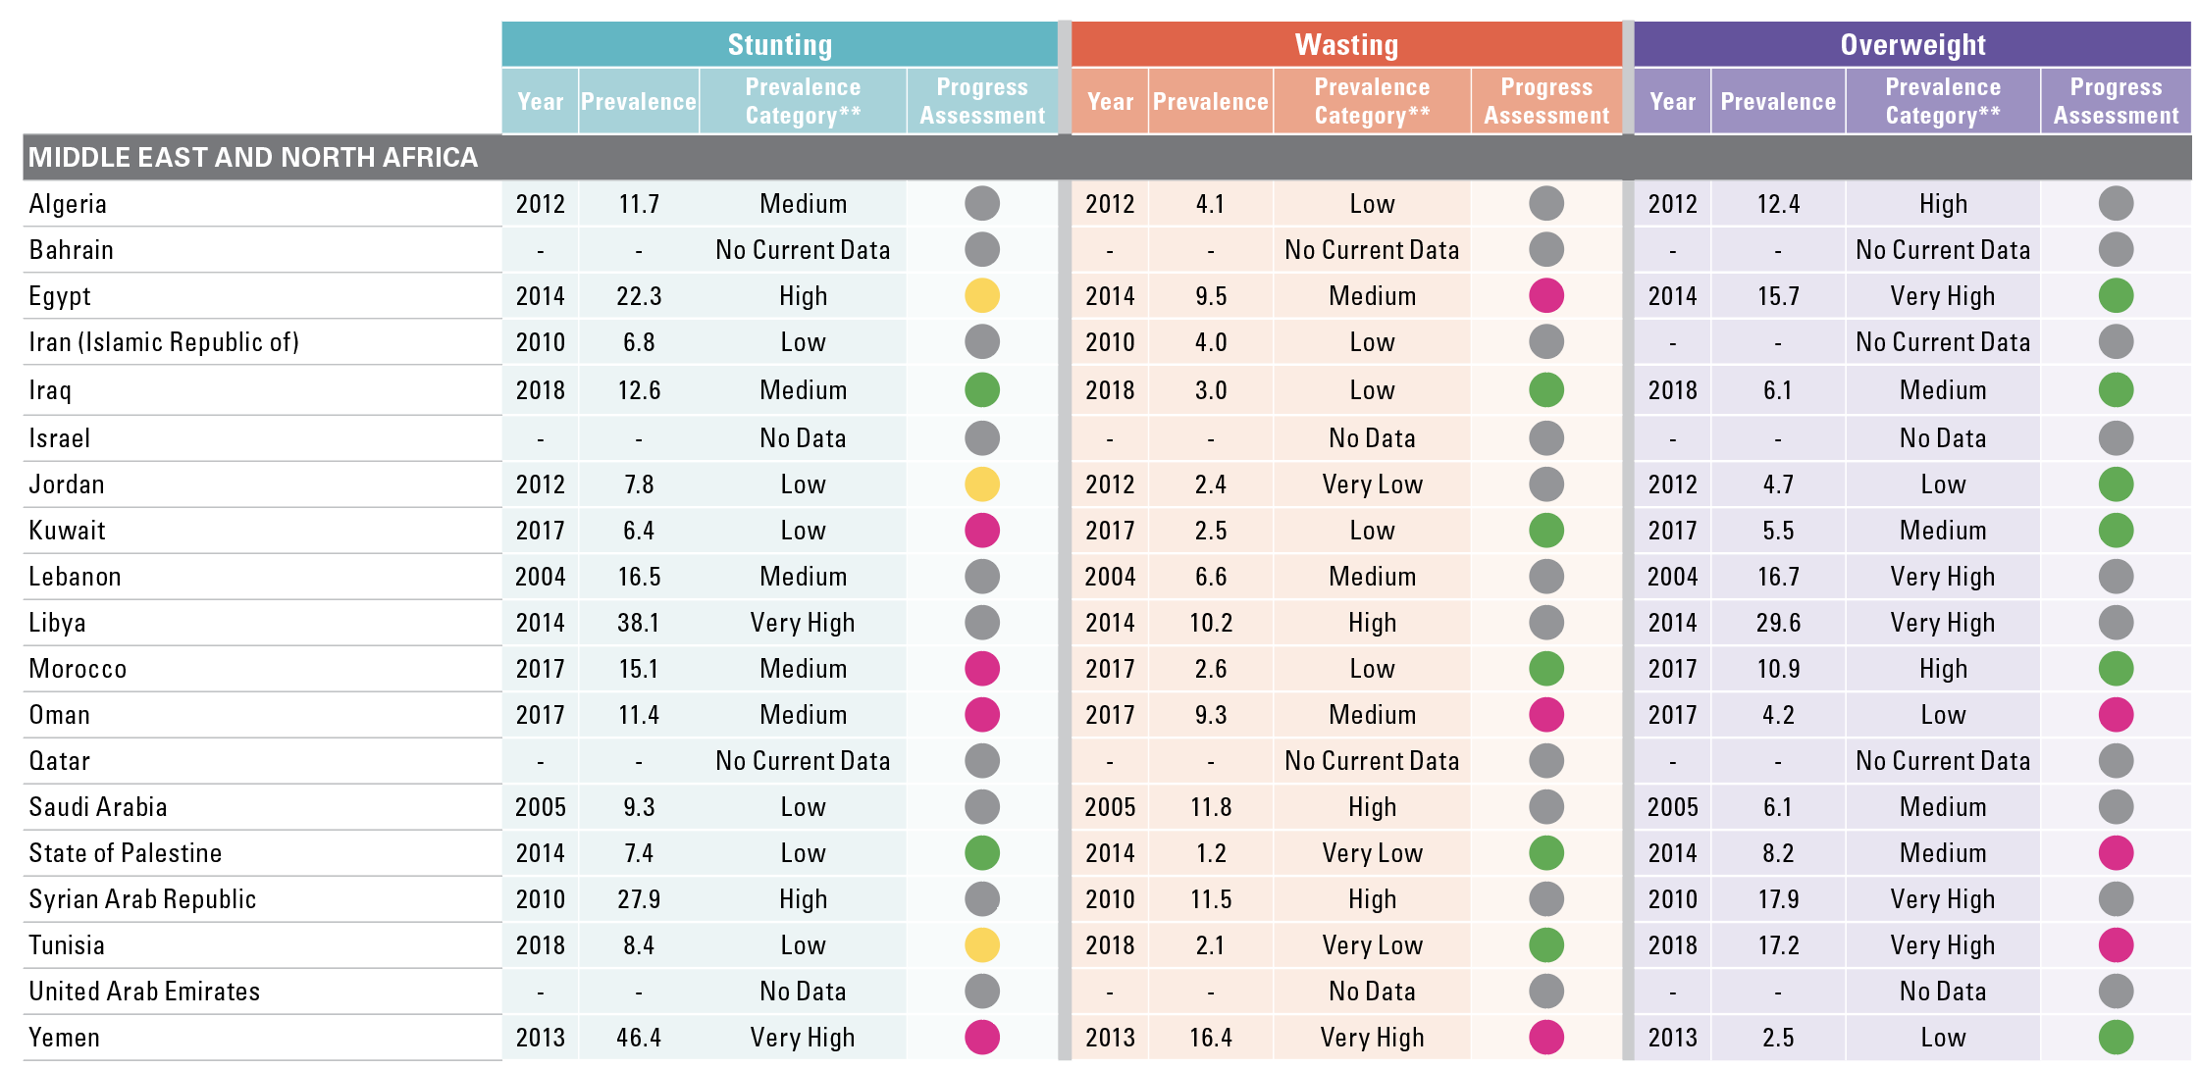
Country Prevalence Table*
Middle East and North Africa
Notes on Progress Assessment: The progress assessment is done against the Sustainable Development Goal Target 2.2 for 2025 using an adapted version of rules from the WHO-UNICEF Technical Expert Advisory Group on Nutrition Monitoring¹ and all available country data between 2008 and 2019 in the 2020 JME country dataset. The annual average rate of reduction (AARR) is calculated for each indicator requiring at least 2 data points, one of which must be more recent than 2012. Alternatively, countries are recorded as being on track if their most recent data point after 2012 is below the on track threshold (e.g. 5% for stunting) even if they have <2 data points in total. Countries not meeting these data availability criteria are reported as “Assessment not possible”.
Notes:
*The most recent estimate between 2000 and 2019 in the JME country dataset is reported in this table, see page 43 for link to full country time series. **See page 40 for prevalence thresholds; No current data means the most recent estimate is from before 2000.
¹ Methodology for monitoring progress towards the global nutrition targets for 2025 – technical report. World Health Organization and the United Nations Children’s Fund (UNICEF) Technical Expert Advisory Group on Nutrition Monitoring (TEAM), 2017. Licence: CC BY-NC-SA 3.0 IGO.

Slide 33
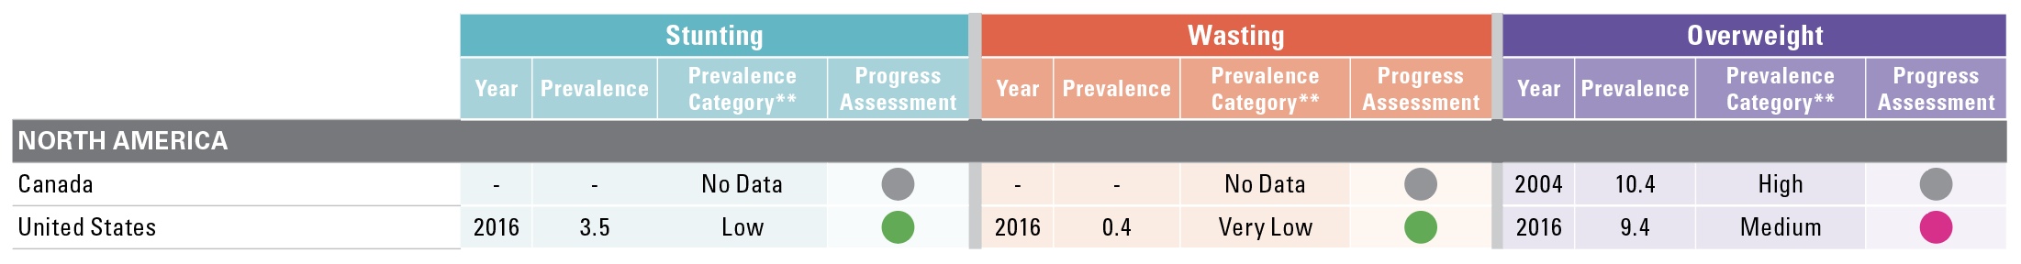
Country Prevalence Table*
North America
Notes on Progress Assessment: The progress assessment is done against the Sustainable Development Goal Target 2.2 for 2025 using an adapted version of rules from the WHO-UNICEF Technical Expert Advisory Group on Nutrition Monitoring¹ and all available country data between 2008 and 2019 in the 2020 JME country dataset. The annual average rate of reduction (AARR) is calculated for each indicator requiring at least 2 data points, one of which must be more recent than 2012. Alternatively, countries are recorded as being on track if their most recent data point after 2012 is below the on track threshold (e.g. 5% for stunting) even if they have <2 data points in total. Countries not meeting these data availability criteria are reported as “Assessment not possible”.
Notes:
*The most recent estimate between 2000 and 2019 in the JME country dataset is reported in this table, see page 43 for link to full country time series. **See page 40 for prevalence thresholds; No current data means the most recent estimate is from before 2000.
¹ Methodology for monitoring progress towards the global nutrition targets for 2025 – technical report. World Health Organization and the United Nations Children’s Fund (UNICEF) Technical Expert Advisory Group on Nutrition Monitoring (TEAM), 2017. Licence: CC BY-NC-SA 3.0 IGO.

Slide 34
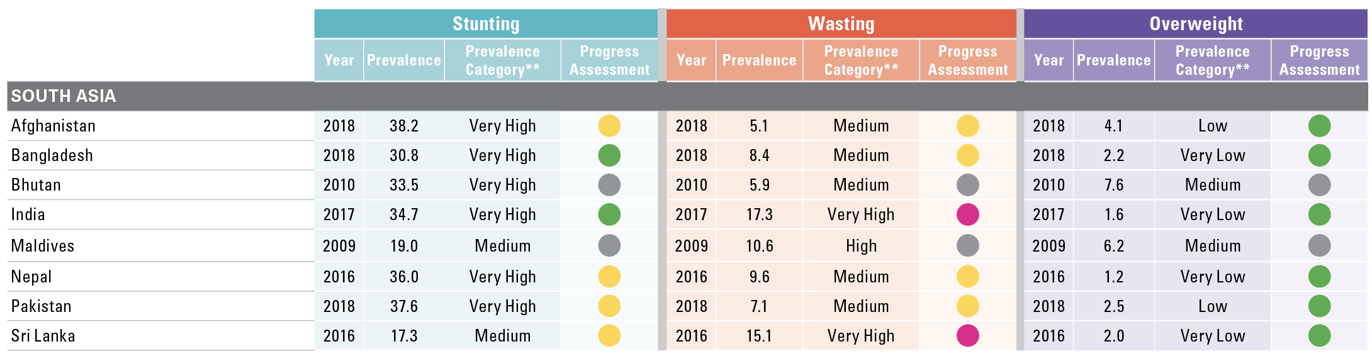
Country Prevalence Table*
South Asia
Notes on Progress Assessment: The progress assessment is done against the Sustainable Development Goal Target 2.2 for 2025 using an adapted version of rules from the WHO-UNICEF Technical Expert Advisory Group on Nutrition Monitoring¹ and all available country data between 2008 and 2019 in the 2020 JME country dataset. The annual average rate of reduction (AARR) is calculated for each indicator requiring at least 2 data points, one of which must be more recent than 2012. Alternatively, countries are recorded as being on track if their most recent data point after 2012 is below the on track threshold (e.g. 5% for stunting) even if they have <2 data points in total. Countries not meeting these data availability criteria are reported as “Assessment not possible”.
Notes:
*The most recent estimate between 2000 and 2019 in the JME country dataset is reported in this table, see page 43 for link to full country time series. **See page 40 for prevalence thresholds; No current data means the most recent estimate is from before 2000.
¹ Methodology for monitoring progress towards the global nutrition targets for 2025 – technical report. World Health Organization and the United Nations Children’s Fund (UNICEF) Technical Expert Advisory Group on Nutrition Monitoring (TEAM), 2017. Licence: CC BY-NC-SA 3.0 IGO.

Slide 35
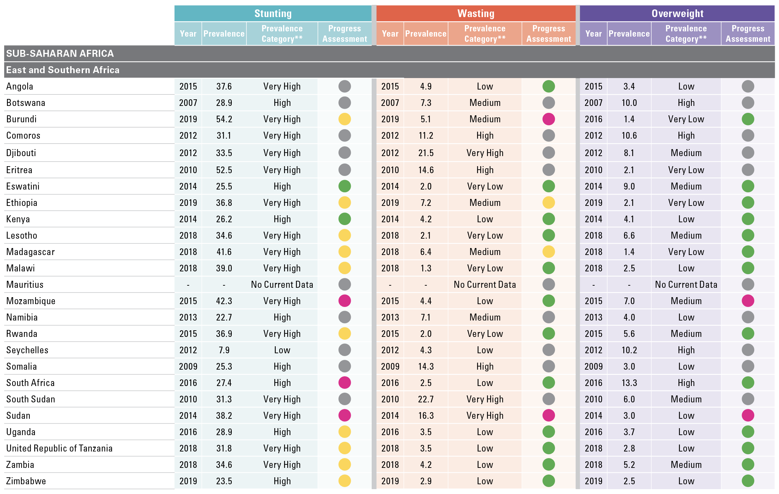
Country Prevalence Table*
East and Southern Africa
Notes on Progress Assessment: The progress assessment is done against the Sustainable Development Goal Target 2.2 for 2025 using an adapted version of rules from the WHO-UNICEF Technical Expert Advisory Group on Nutrition Monitoring¹ and all available country data between 2008 and 2019 in the 2020 JME country dataset. The annual average rate of reduction (AARR) is calculated for each indicator requiring at least 2 data points, one of which must be more recent than 2012. Alternatively, countries are recorded as being on track if their most recent data point after 2012 is below the on track threshold (e.g. 5% for stunting) even if they have <2 data points in total. Countries not meeting these data availability criteria are reported as “Assessment not possible”.
Notes:
*The most recent estimate between 2000 and 2019 in the JME country dataset is reported in this table, see page 43 for link to full country time series. **See page 40 for prevalence thresholds; No current data means the most recent estimate is from before 2000.
¹ Methodology for monitoring progress towards the global nutrition targets for 2025 – technical report. World Health Organization and the United Nations Children’s Fund (UNICEF) Technical Expert Advisory Group on Nutrition Monitoring (TEAM), 2017. Licence: CC BY-NC-SA 3.0 IGO.

Slide 36
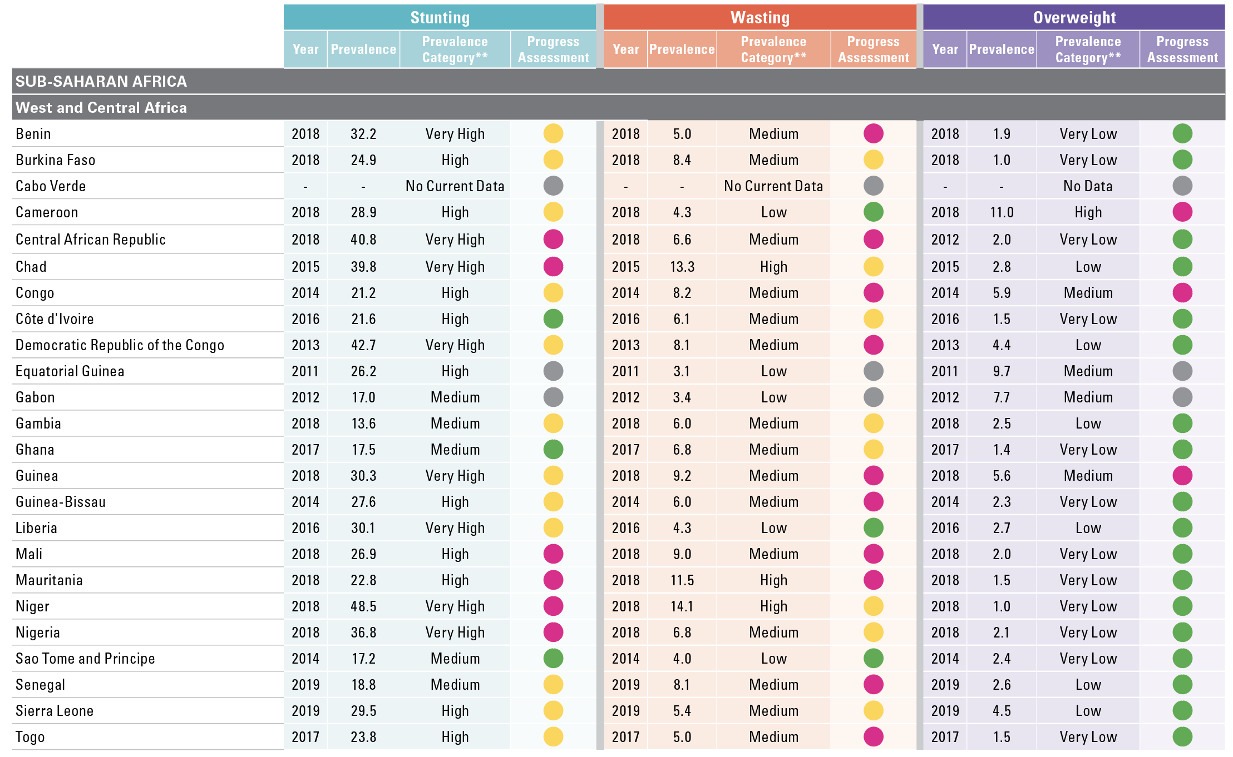
Country Prevalence Table*
West and Central Africa
Notes on Progress Assessment: The progress assessment is done against the Sustainable Development Goal Target 2.2 for 2025 using an adapted version of rules from the WHO-UNICEF Technical Expert Advisory Group on Nutrition Monitoring¹ and all available country data between 2008 and 2019 in the 2020 JME country dataset. The annual average rate of reduction (AARR) is calculated for each indicator requiring at least 2 data points, one of which must be more recent than 2012. Alternatively, countries are recorded as being on track if their most recent data point after 2012 is below the on track threshold (e.g. 5% for stunting) even if they have <2 data points in total. Countries not meeting these data availability criteria are reported as “Assessment not possible”.
Notes:
*The most recent estimate between 2000 and 2019 in the JME country dataset is reported in this table, see page 43 for link to full country time series. **See page 40 for prevalence thresholds; No current data means the most recent estimate is from before 2000.
¹ Methodology for monitoring progress towards the global nutrition targets for 2025 – technical report. World Health Organization and the United Nations Children’s Fund (UNICEF) Technical Expert Advisory Group on Nutrition Monitoring (TEAM), 2017. License: CC BY-NC-SA 3.0 IGO.

Slide 37
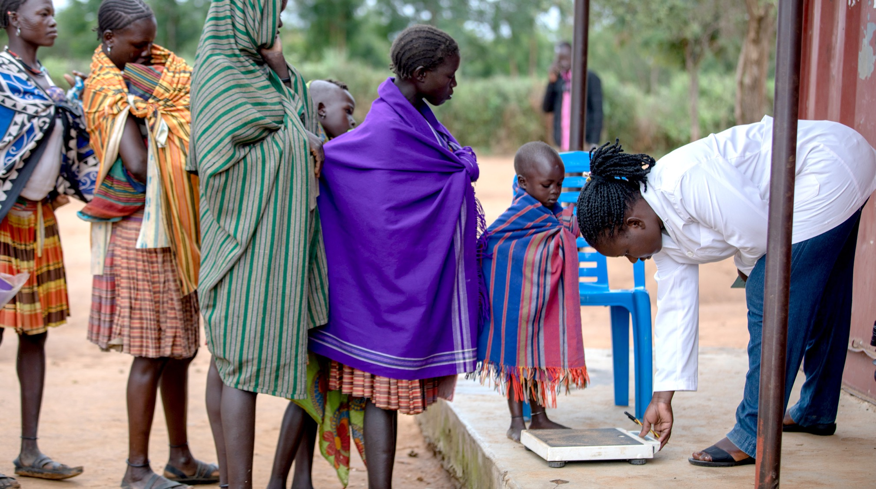

NOTES ON THE DATA AND METHODOLOGY

Slide 38
Strengths and weaknesses of malnutrition data
Prevalence estimates for stunting and overweight are relatively stable over the course of a calendar year. It is therefore possible to track global and regional changes in these two conditions over time. Wasting and severe wasting are acute conditions that can change frequently and rapidly over the course of a calendar year. This makes it difficult to generate reliable trends over time with the input data available, and as such, this report provides only most recent global and regional estimates.
The joint global and regional estimates that make up the UNICEF/ WHO/World Bank Group Joint Child Malnutrition Estimates have been generated using a country-level dataset which is mainly comprised of estimates from nationally representative household surveys. These data are collected infrequently (every 3 to 5 years in most countries) and measure malnutrition at one point in time (e.g. during one or several months of field work), making it difficult to capture the rapid fluctuations in wasting that can occur over the course of a given year. Incidence data (i.e. the number of new cases that occur during the calendar year) would allow for better tracking of changes over time; however, these data currently do not exist.

Slide 39
The analysis methods and presentation have remained unchanged from the 2012 report¹, except for minor refinements detailed below:
1. Year assigned to each survey
When data collection begins in one calendar year and continues into the next, the survey year assigned is the one in which most of the fieldwork took place. For example, if a survey was conducted between 1 September 2009 and 28 February 2010, the year 2009 would be assigned, since the majority of data collection took place in that year (i.e., four months in 2009 versus two months in 2010). This method has been used since the 2013 edition (prior to that, the latter year was used by default – e.g., 2010 in the example above).
2. Final reports only
As of the 2014 edition, the country-level dataset used to generate the global and regional joint malnutrition estimates is based only on final survey results. Preliminary survey results are no longer included in the
dataset since the data are sometimes retracted or change significantly
when the final version is released.
3. Updated data sources
i. The updated joint dataset includes:
• 854 nationally representative surveys;
• data from 152 countries and territories, representing more than 90 per cent of all children under 5 globally (population coverage varies by regions and periods). The majority of data available are from low- and middle-income countries – more efforts are needed to generate data from high-income countries.
ii. The under 5 population estimates were based on The United Nations World Population Prospects, 2017 Revision. These were used as weighting factors for each country survey to derive the regional and global prevalence estimates and calculate the numbers affected.
iii. Regional and country income classifications were based on FY19 World Bank income classification.
4. Footnotes on population coverage
As started in the 2014 edition, a separate exercise was conducted to assess population coverage. This was important in order to alert the reader, via footnotes, to instances where the data should be interpreted with caution due to low population coverage (defined as less than 50 per cent). A conservative method was applied looking at available data within mutually exclusive five-year periods around the projected years.
1 United Nations Children’s Fund, World Health Organization, The World Bank. UNICEF-WHO-World Bank Joint Child Malnutrition Estimates. (UNICEF, New York; WHO, Geneva; The World Bank, Washington, DC; 2012).

Slide 40
The analysis methods and presentation have remained unchanged from the 2012 report¹, except for minor refinements detailed below:
5. Prevalence thresholds for wasting, overweight and
stunting in children under 5 years
New thresholds, presented in the table on the right, were established through the WHO-UNICEF Technical Advisory Group on Nutrition Monitoring (TEAM)² and have been used for development of prevalence-based maps in this brochure. The thresholds were developed in relation to standard deviations (SD) of the normative WHO Child Growth Standards. The international definition of ‘normal’ (two SD from the WHO standards median) defines the first threshold, which includes 2.3% of the area under the normalized distribution. Multipliers of this “very low” level (rounded to 2.5%) set the basis to establish subsequent thresholds.
Labels | Prevalence thresholds (%)
 | Stunting | Overweight and Wasting
Very Low | <2.5 | <2.5
Low | 2.5 – < 10 | 2.5 – < 5
Medium | 10 – < 20 | 5 – < 10
High | 20 – < 30 | 10 – < 15
Very high | ≥ 30 | ≥ 15
1 United Nations Children’s Fund, World Health Organization, The World Bank. UNICEF-WHO-World Bank Joint Child Malnutrition Estimates. (UNICEF, New York; WHO, Geneva; The World Bank, Washington, DC; 2012).
2 de Onis, M., et al. (2018). Prevalence thresholds for wasting, overweight and stunting in children under 5 years. Public health nutrition, 22(1), 175–179.

Slide 41
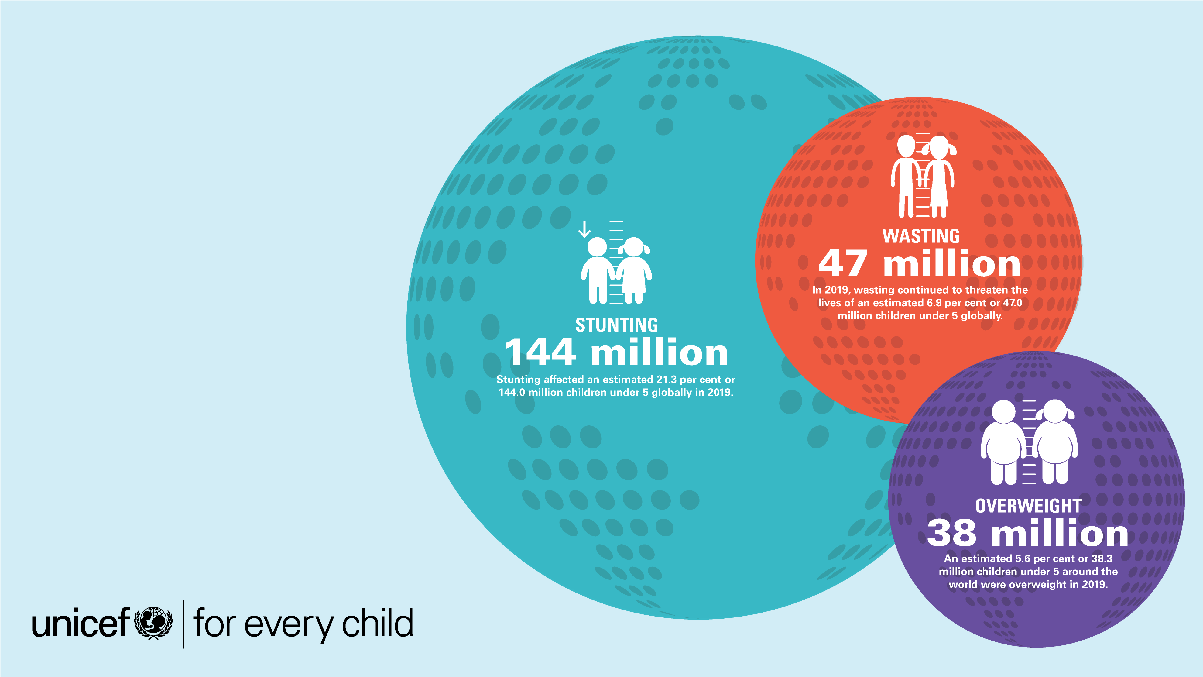
ONLINE
MATERIALS

Slide 42
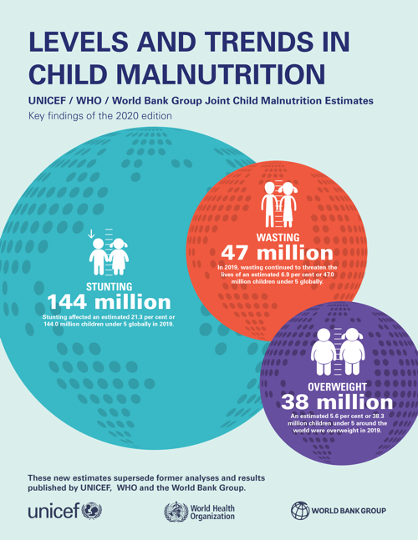
ONLINE MATERIALS
Key Findings Report
This key findings report of the 2020 Edition of the Joint Child Malnutrition Estimates summarizes the new regional and global numbers and main messages for official United Nations data on child malnutrition.
Available at: https://data.unicef.org/resources/jme-report-2020/

Slide 43
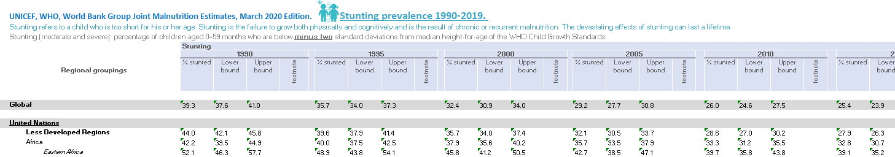
ONLINE MATERIALS
Databases
There are joint malnutrition global and regional estimates database by various regional groupings (e.g. United Nations, UNICEF, WHO, etc., regional groupings) and for more years than presented in the report.
There are also country-level expanded databases (e.g. disaggregated by sex, wealth, areas of residence, etc.) for the following indicators:
Stunting
Wasting
Severe Wasting
Overweight
Overlapping Malnutrition
The databases are available at: https://data.unicef.org/resources/dataset/malnutrition-data/

Slide 44
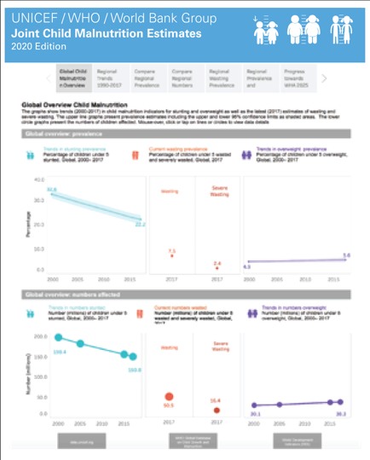
ONLINE MATERIALS
Interactive Dashboards
Interactive dashboards, which allow users to visualize and
export the global and regional estimates for a number of
regional groupings.
Available at: https://data.unicef.org/resources/joint-child-malnutrition-estimates-interactive-dashboard/

Slide 45
Prepared by:
Data and Analytics Section,
Division of Data, Research & Policy
UNICEF Headquarters
3 UN Plaza, New York, NY, 10017
data.unicef.org
For more information contact:
data@unicef.org

